Slide 1



Deploying and managing DC/OS clusters in Microsoft Azure.
Dmitry Shmulevich

Slide 2
Agenda
ARM – Azure Resource Manager
ARM template
dcos-engine
DC/OS for Windows
Demo: deploy, scale, upgrade
Q&A

Slide 3
Provisioning resources in ARM
Azure Resource Manager (ARM) provides unified interface for deploying and managing resources.
Resource is a functional unit in Azure infrastructure, such as storage, VM, IP address, DB, etc.
Resource group constitutes a collection of resources that support an application or workload
Resource provider (RP) creates and manages resources of specific class. For example:
Storage RP – Storage Account,
Disk RP - Managed Disk
Network RP – IP Address, VNET, Load Balancer
Compute RP – VM, VM Scale Set, VM Availability Set

Slide 4
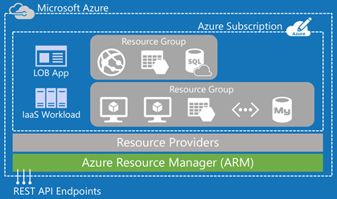
Provisioning resources in ARM (cont.)

Slide 5
Provisioning resources in ARM (cont.)
ARM clients
Azure Portal
an easy-to-use graphical UX
Azure CLI
a multiplatform command line interface
Azure Powershell
a set of cmdlets using ARM model for resource management
Azure Cloud Shell
an authenticated browser based shell tool hosted in the cloud
Azure SDK
.NET, Java, Node, Python, Go, Ruby, PHP, etc.

Slide 6
Provisioning resources in ARM (cont.)
ARM Template
Is a JSON file
Is declarative and repeatable
Describes entire topology of the application
Specifies resources, dependencies, and connections
Parametrized input/output
Ensures idempotency
Simplifies orchestration
Provides Cross-Resource Configuration and Update support

Slide 7
dcos-engine
is as open source project https://github.com/Azure/dcos-engine/
initiated by Microsoft team
allows to create, deploy, and manage highly customizable DC/OS cluster templates
leverages advanced network, storage, compute, and security infrastructure of Azure
contributes to container democratization in Azure

Slide 8
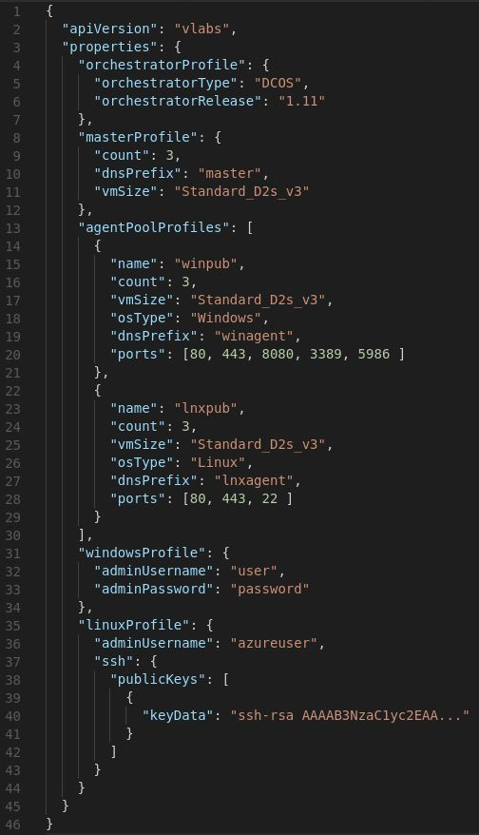
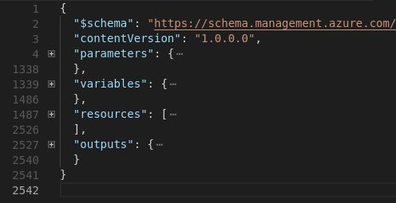
dcos-engine template generation workflow
Cluster API model
dcos-engine
ARM template
(2542 lines)
ARM Template
Parameters
API model
ARM
API model
(46 lines)
Azure

Slide 9
dcos-engine features
Node pre- and post- provision
master and agents
Authentication
Oauth
Master-agent
Configurable cluster
number of master nodes
DC/OS version or release
Multiple Agent Pools
Multiple Network configurations
private pools
public pools with configurable ports
custom VNET
Configurable count of VMs in the pool
OS: Linux or Windows
VM features: GPU, SSD, Large memory
Disks
- configurable OS disk size
- configurable count of attached disks
- configurable size of attached disks

Slide 10
Running DC/OS on Windows
Ported DCOS services
Mesos
DCOS-Diagnostics
DCOS-Metrics
DCOS-Net
Adminrouter (using Apache HTTP server instead of nginx)
Ported systemd for service support on Windows
Ported Pkgpanda build and deploy
Introduced Windows bootstrap node
Added support for in-place upgrade of Windows nodes
Implemented end-to-end CI/CD infrastructure for test, build, and validation

Slide 11
Continuous Integration & Deployment for Hybrid DC/OS cluster
DC/OS and Mesos upstream CICD integration
Cluster Scaling/Upgrade test
End-to-end scenario tests
Mesos Unit tests/Integration tests
Mesos Nightly Build
Deployment with dcos-engine
DC/OS Linux Master node
DC/OS
cluster
DCOS Master nodes
DCOS Master nodes
Admin Router
Cluster management
Networking
Linux Bootstrap node
Mesos Master
Exhibitor &
ZooKeeper
DCOS-NET
Mesos DNS
PkgPanda
Container Orchestration
Other components
Other components
PkgPanda
Marathon
Metronome
Other components
Windows Bootstrap node
PkgPanda
DC/OS Windows Agent node
PkgPanda
Admin Router
Mesos-Agent
DC/OS Linux Agent node
Networking
Auth
Logging
DNS
Diagnostics
Metrics
Docker task Health check
AsyncIO Library for LibProcess
Mesos Fetcher
Legend
Custom extension via Pre-provision
Mesos Cmake Build System
Mesos Compressor/Decompressor
Docker Containerizer
Existing Components
Developed by Microsoft
Aqua
Fluentd
MSI Proxy
Azure infrastructure

Slide 12
Running DC/OS on Windows (cont.)
c:\>dir c:\opt
10/01/2018 05:11 PM <DIR> mesosphere
0 File(s) 0 bytes
3 Dir(s) 18,193,772,544 bytes free
c:\>dir c:\etc
10/01/2018 05:06 PM <DIR> mesosphere
10/01/2018 05:07 PM <DIR> systemd
0 File(s) 0 bytes
4 Dir(s) 18,193,727,488 bytes free
c:\>dir c:\var\lib
10/01/2018 05:13 PM <DIR> dcos
10/01/2018 05:12 PM <DIR> mesos
0 File(s) 0 bytes
4 Dir(s) 18,201,948,160 bytes free

Slide 13
Running DC/OS on Windows (cont.)
c:\>dir c:\etc\systemd\system
09/19/2018 02:08 PM 597 dcos-adminrouter-agent.service
09/19/2018 02:08 PM 811 dcos-diagnostics.service
10/01/2018 05:07 PM 811 dcos-download.service
09/19/2018 02:08 PM 415 dcos-gen-resolvconf.service
09/19/2018 02:08 PM 159 dcos-gen-resolvconf.timer
09/19/2018 02:08 PM 1,026 dcos-mesos-slave-public.service
09/19/2018 02:08 PM 842 dcos-metrics-agent.service
09/19/2018 02:08 PM 406 dcos-net-watchdog.service
09/19/2018 03:31 PM 1,788 dcos-net.service
09/19/2018 02:08 PM 512 dcos-portalocker.service
10/01/2018 05:07 PM 451 dcos-setup.service
10/01/2018 05:08 PM 37 dcos.target
10/01/2018 05:11 PM <DIR> dcos.target.wants
12 File(s) 7,855 bytes
3 Dir(s) 18,201,063,424 bytes free

Slide 14
Running DC/OS on Windows (cont.)
c:\>c:\opt\mesosphere\bin\systemctl.exe list-units
dcos-adminrouter-agent.service
dcos-diagnostics.service
dcos-gen-resolvconf.service
dcos-gen-resolvconf.timer
dcos-mesos-slave-public.service
dcos-metrics-agent.service
dcos-net-watchdog.service
dcos-net.service
dcos-portalocker.service
dcos.target
c:\>c:\opt\mesosphere\bin\systemctl.exe is-active dcos-net.service
active

Slide 15


Slide 16
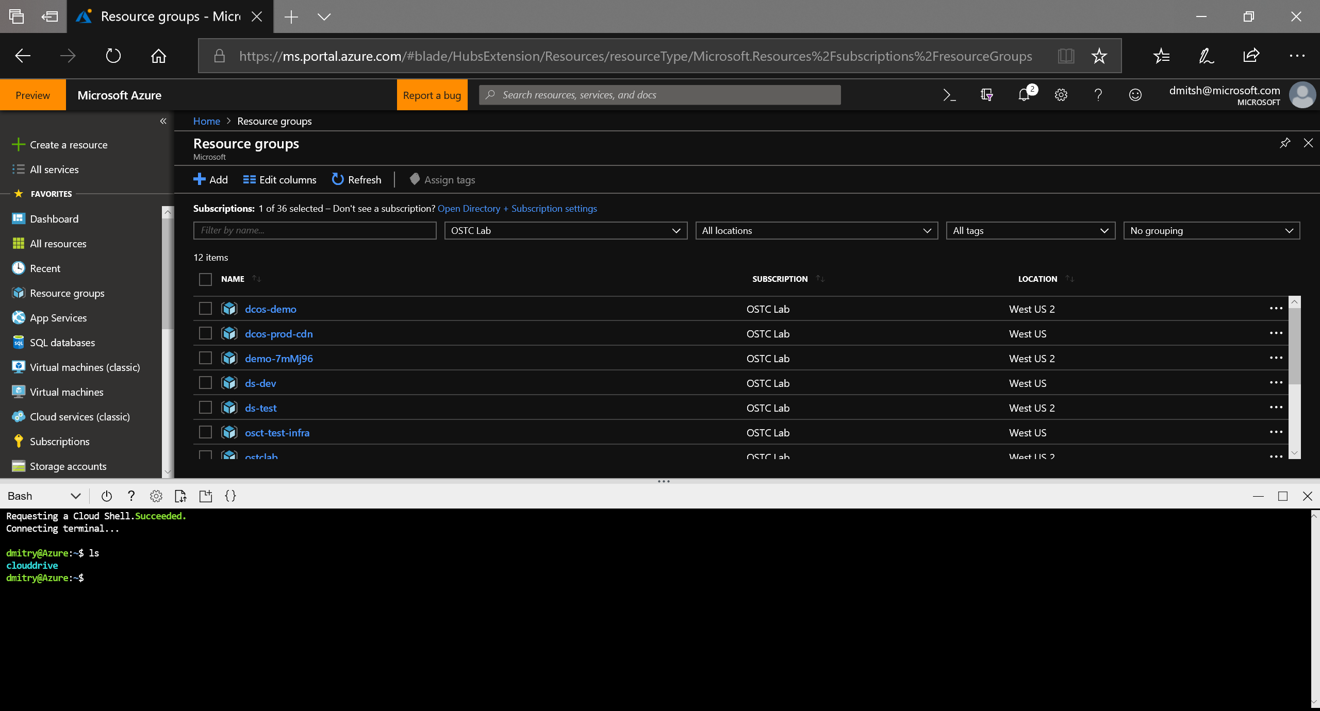
Demo: Cloud shell

Slide 17
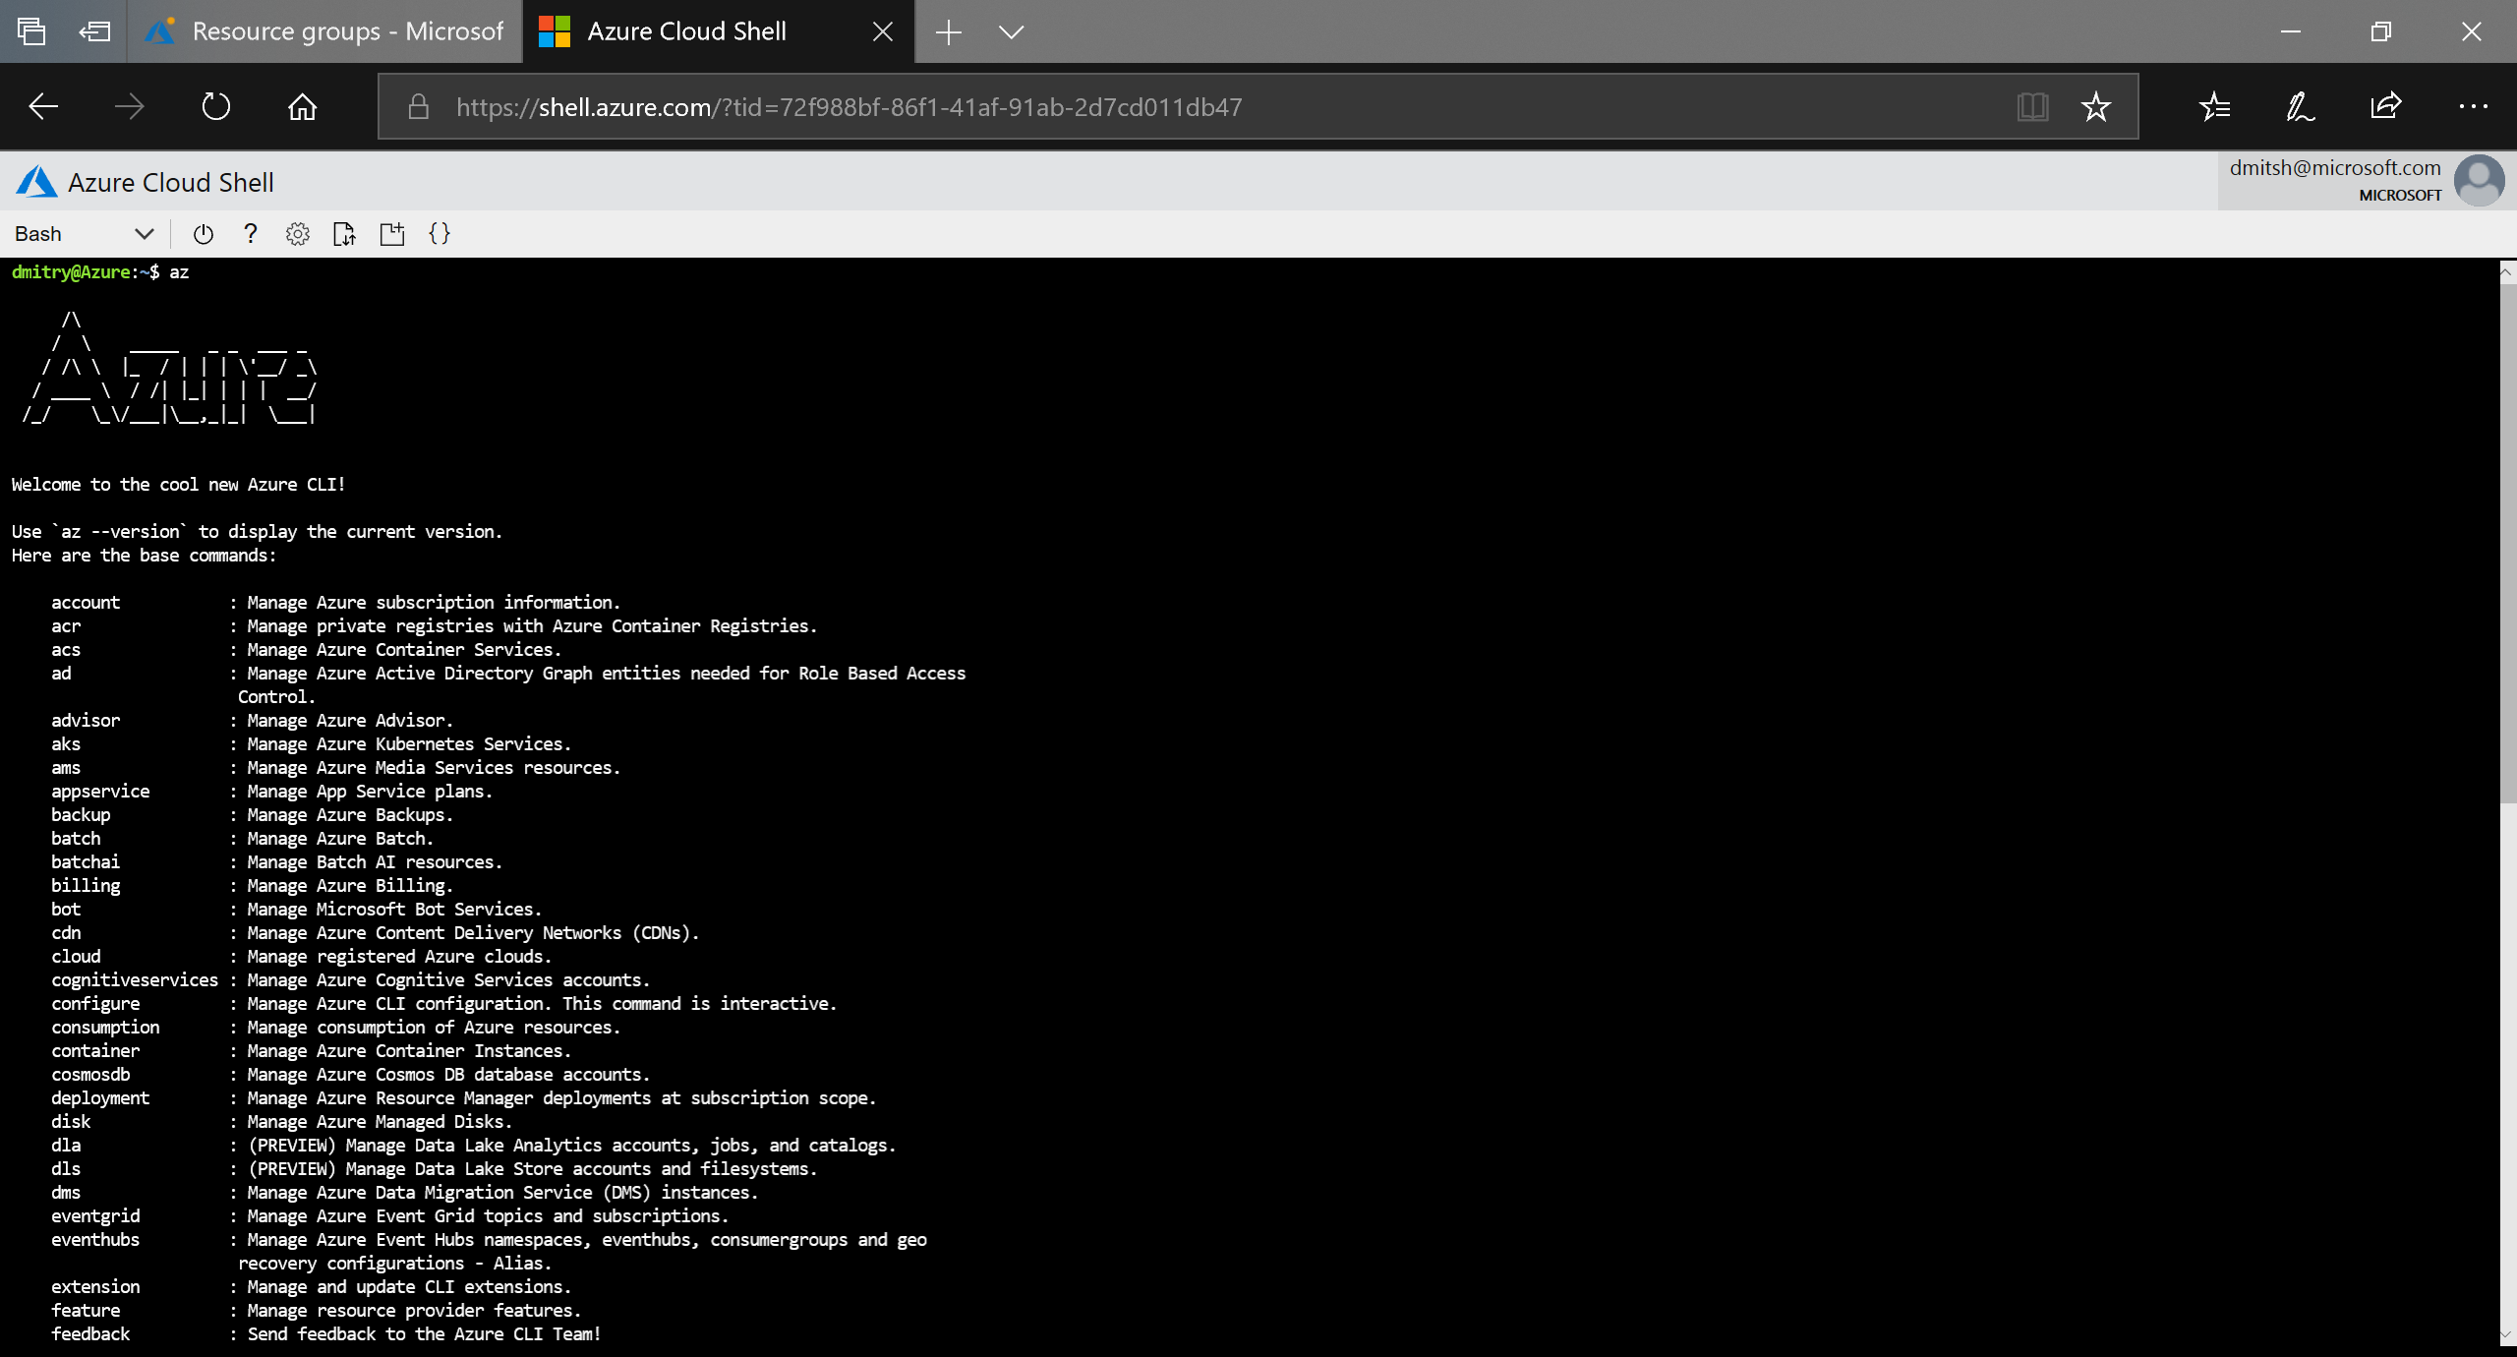
Demo: Cloud shell (cont.)

Slide 18
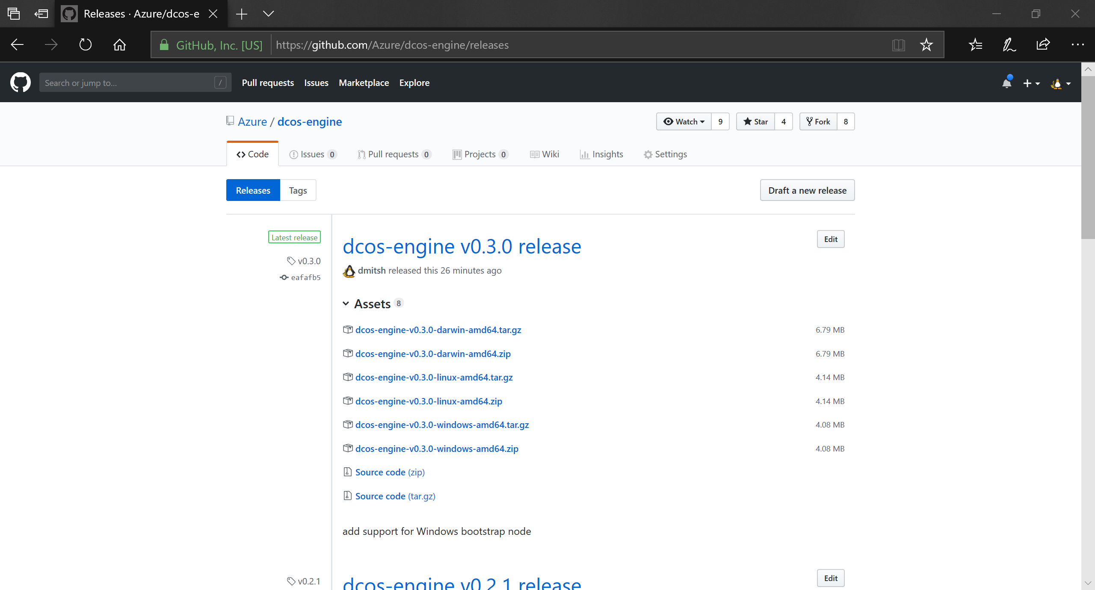
Demo: getting dcos-engine

Slide 19
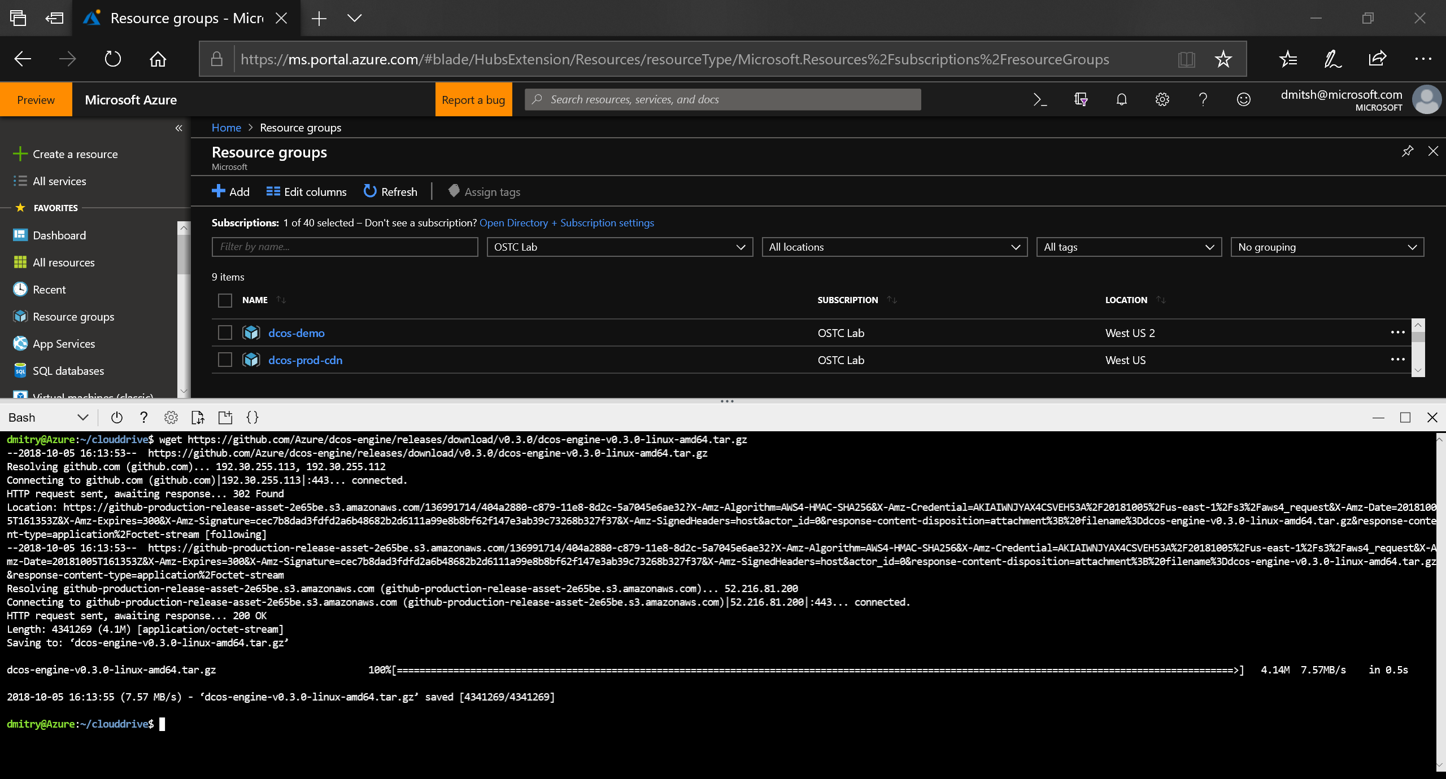
Demo: getting dcos-engine (cont.)

Slide 20
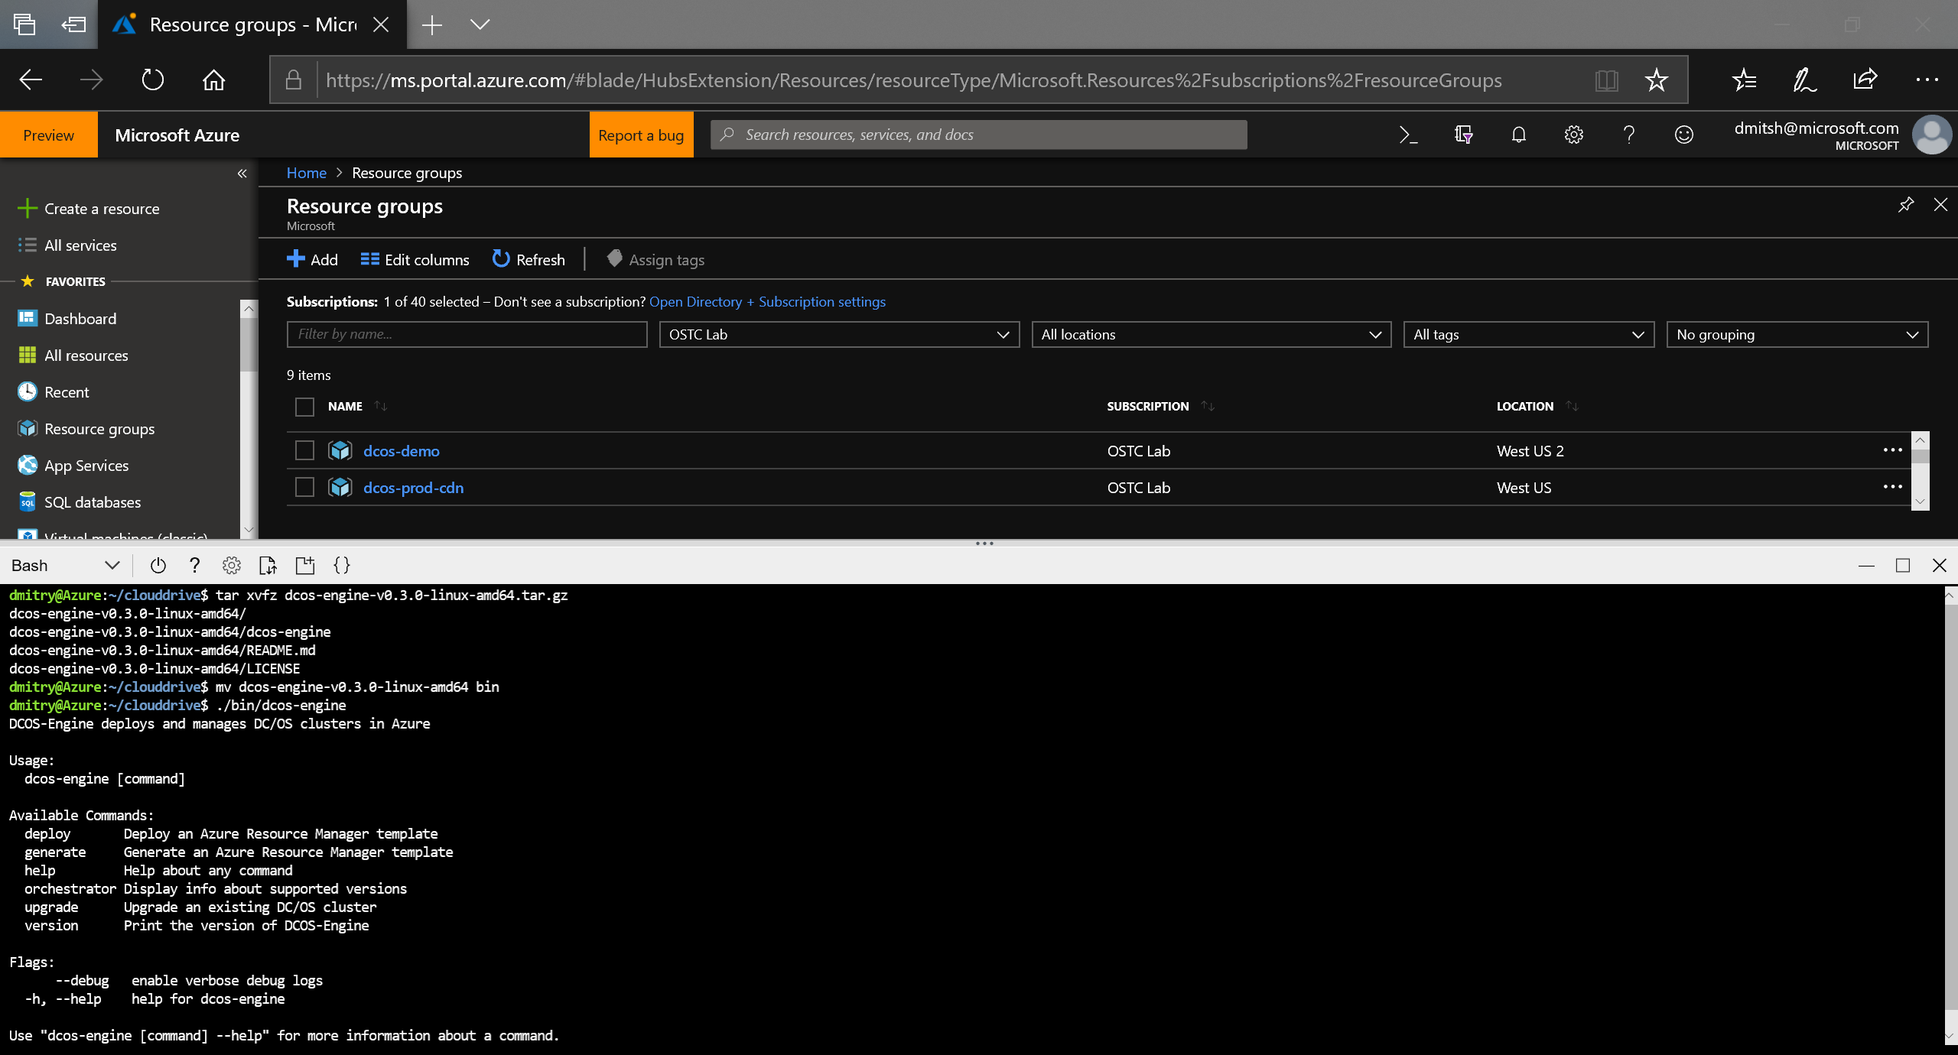
Demo: getting dcos-engine (cont.)

Slide 21
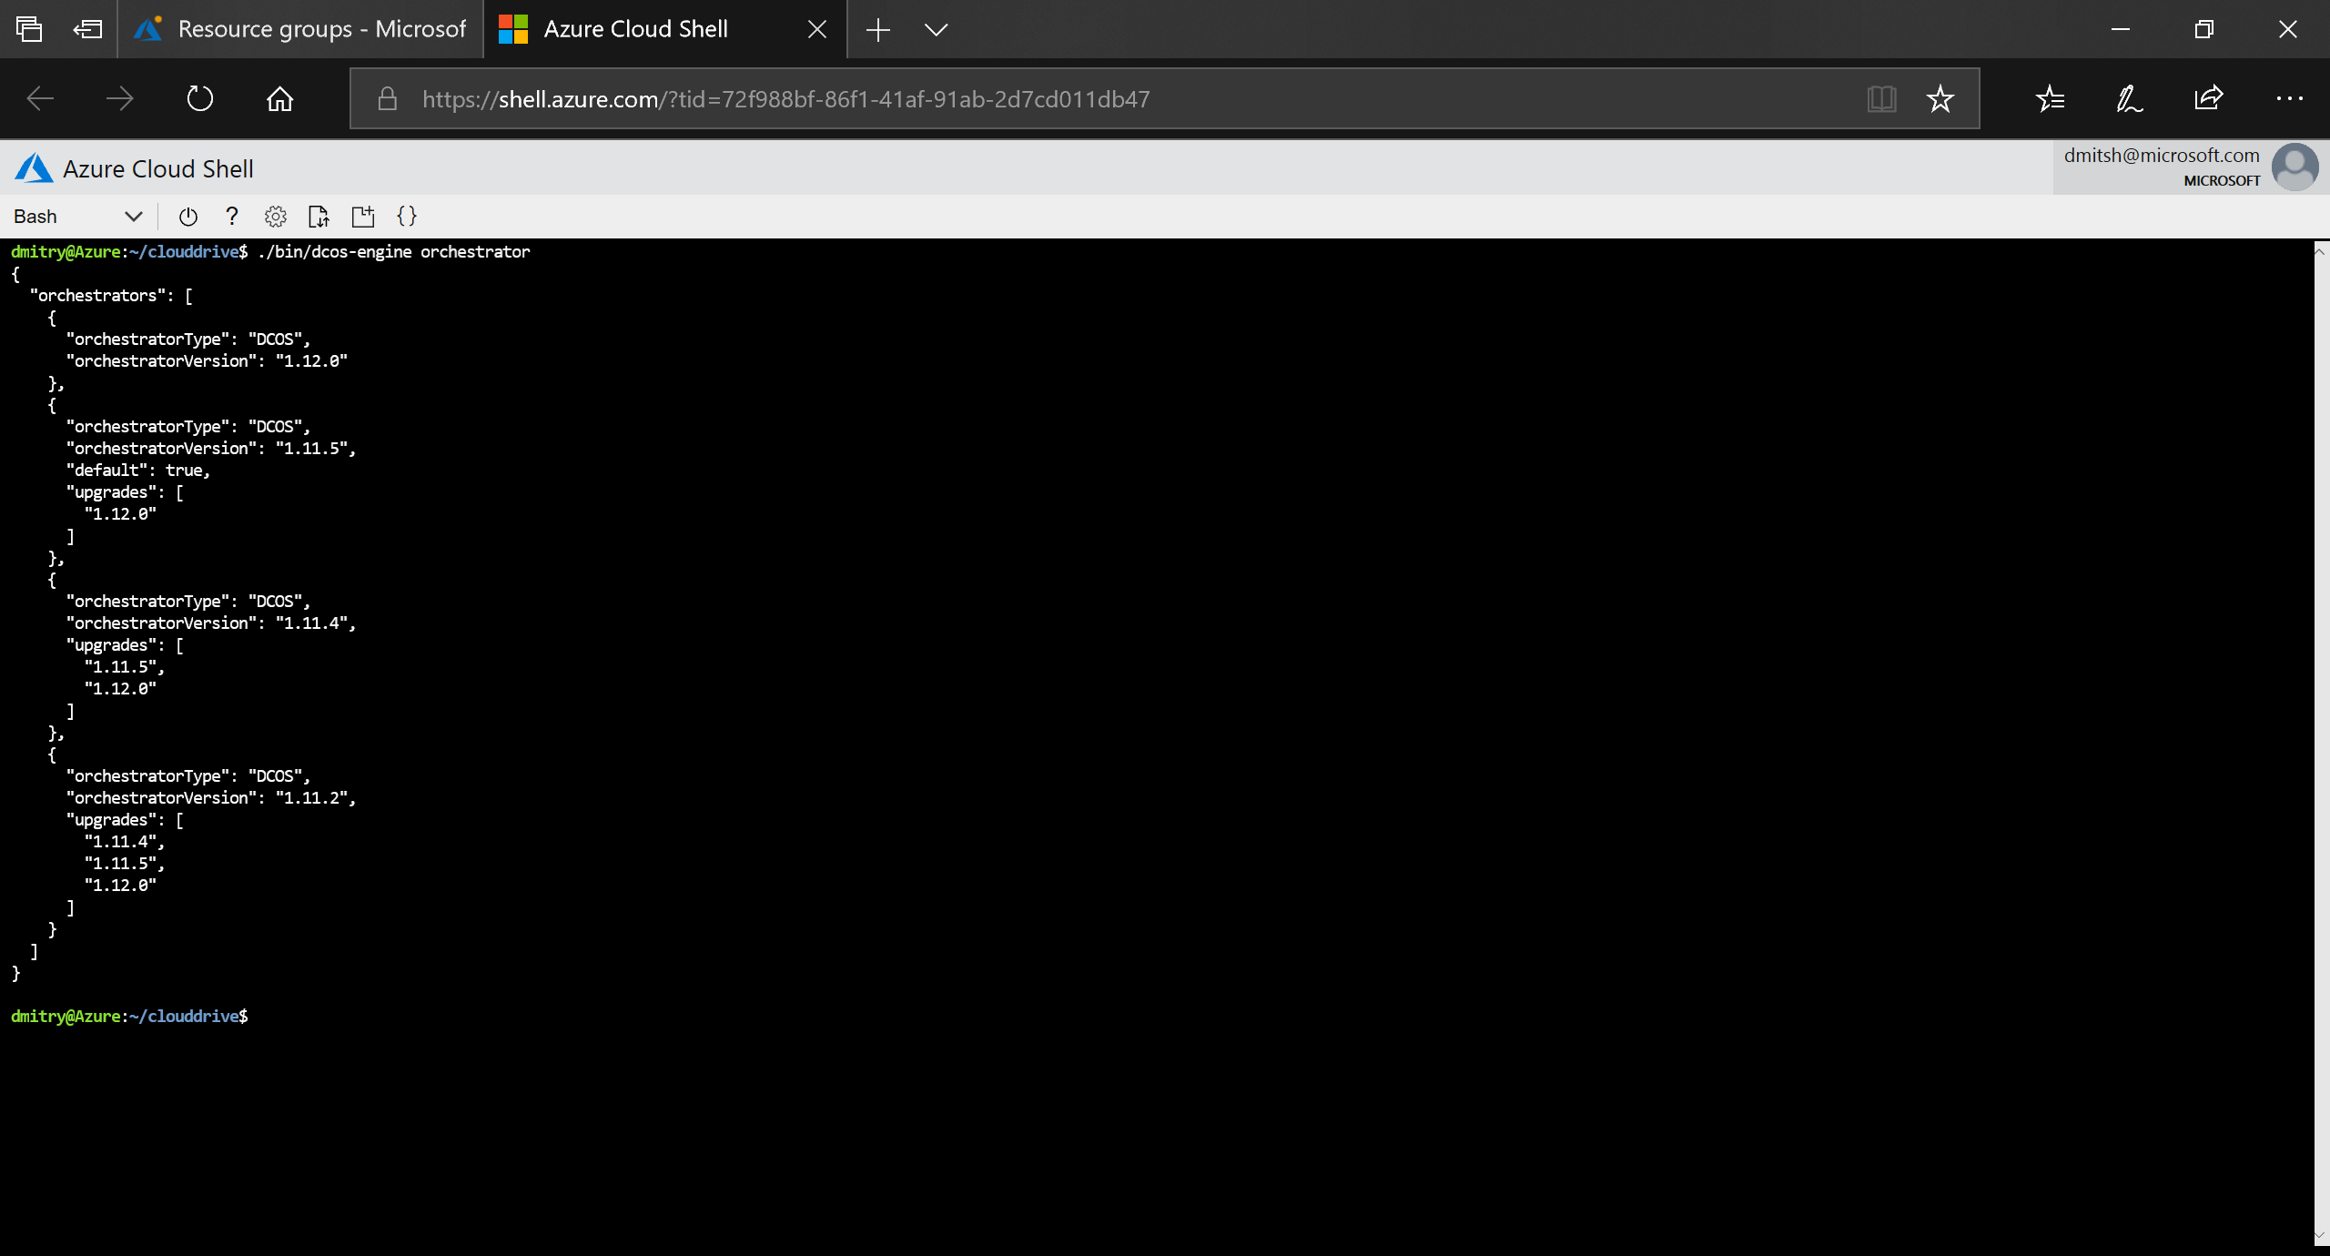
Demo: cluster deployment (cont.)

Slide 22
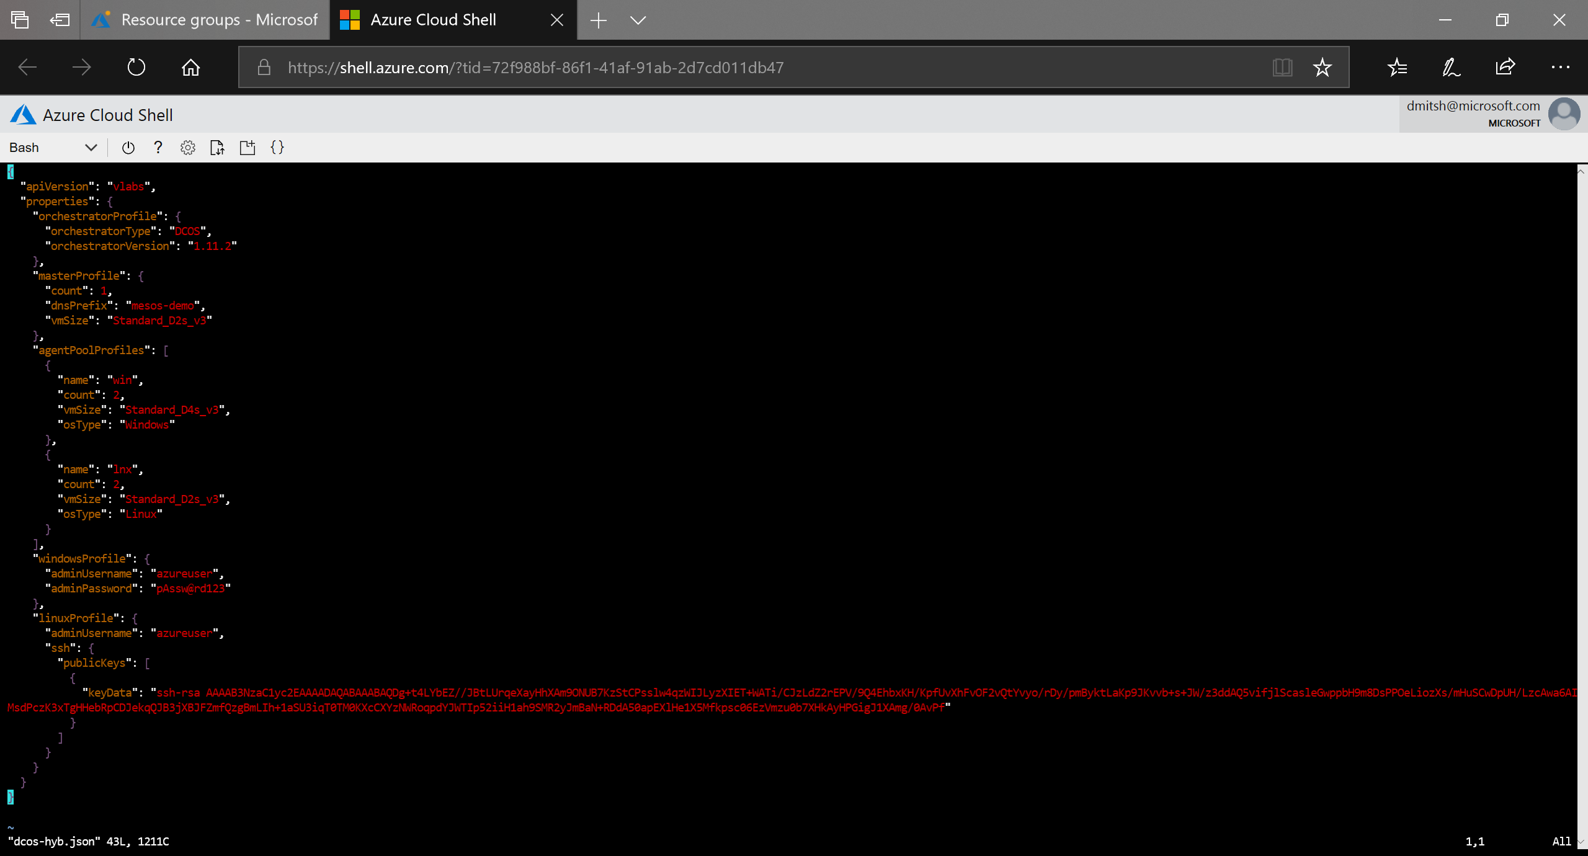
Demo: cluster deployment (cont.)
DC/OS Version: 1.11.2
Master nodes: 1
DNS: mesos-demo.<location>.cloudapp.azure.com
Compute: 2 vCPU, 8 GiB
Agent pool name: “win”
Agent nodes: 2
Compute: 4 vCPU, 16 GiB
Agent OS: Windows
Agent pool name: “lnx”
Agent nodes: 2
Compute: 2 vCPU, 8 GiB
Agent OS: Linux

Slide 23
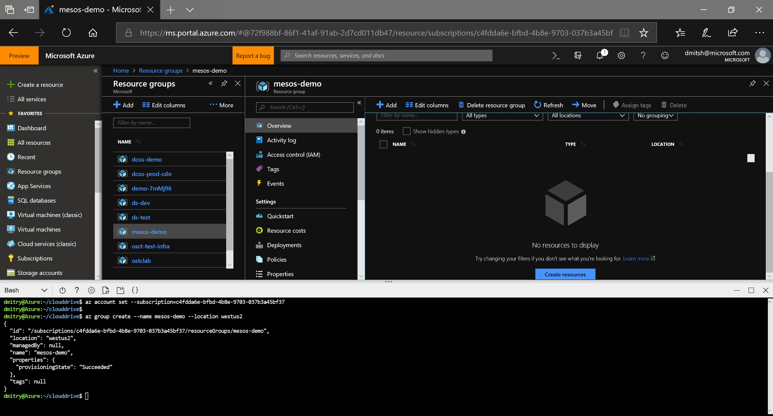
Demo: cluster deployment (cont.)

Slide 24
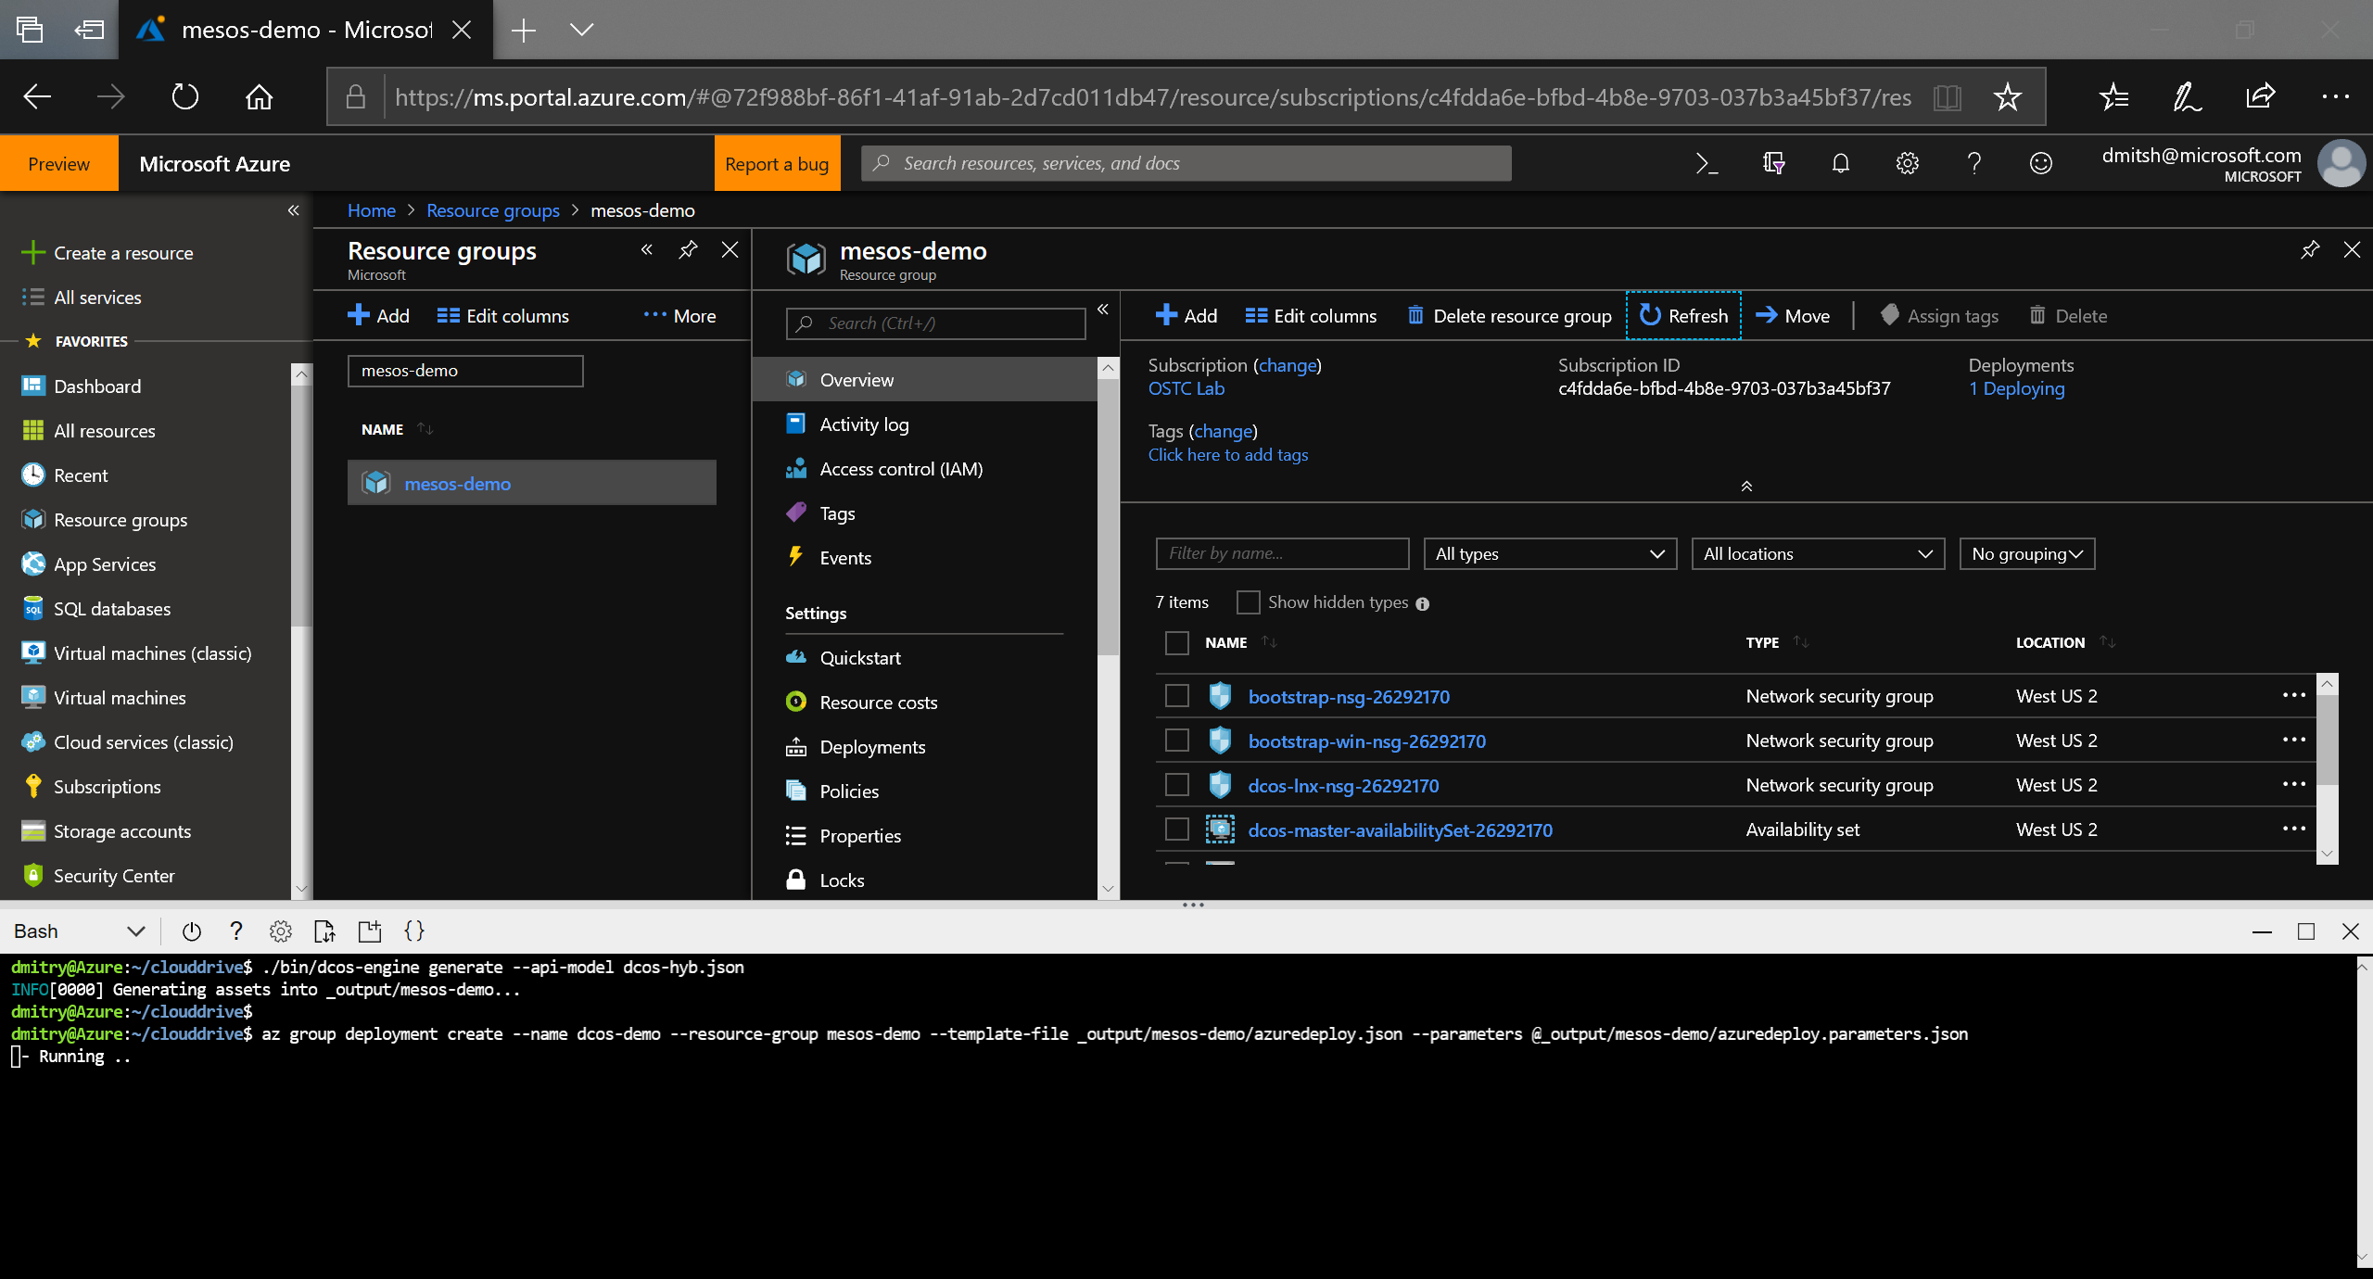
Demo: cluster deployment (cont.)

Slide 25
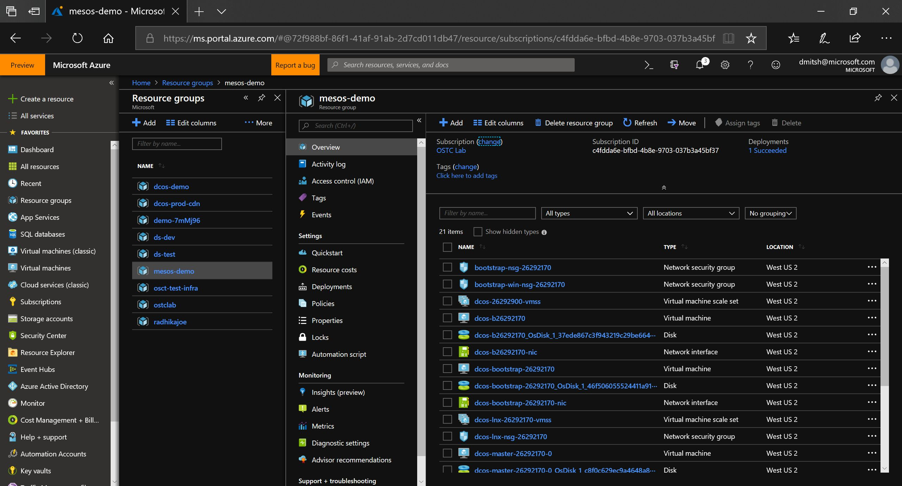
Demo: cluster deployment (cont.)

Slide 26
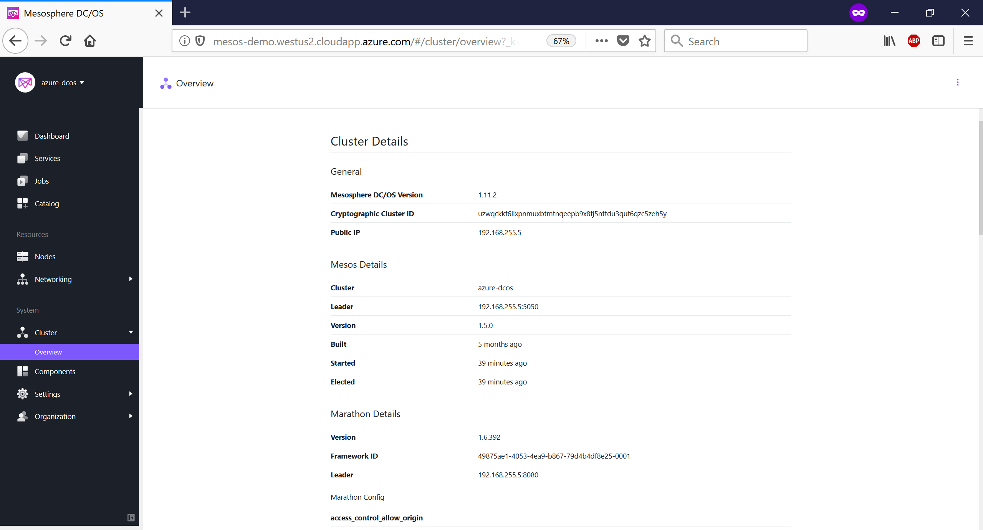
Demo: cluster deployment (cont.)

Slide 27
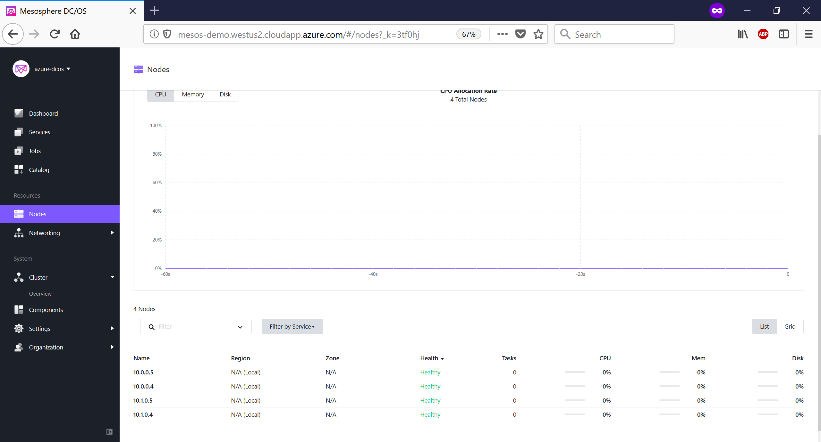
Demo: cluster deployment (cont.)

Slide 28

Demo: cluster deployment (cont.)

Slide 29

Demo: cluster deployment (cont.)

Slide 30

Demo: cluster deployment (cont.)

Slide 31

Demo: cluster deployment (cont.)

Slide 32
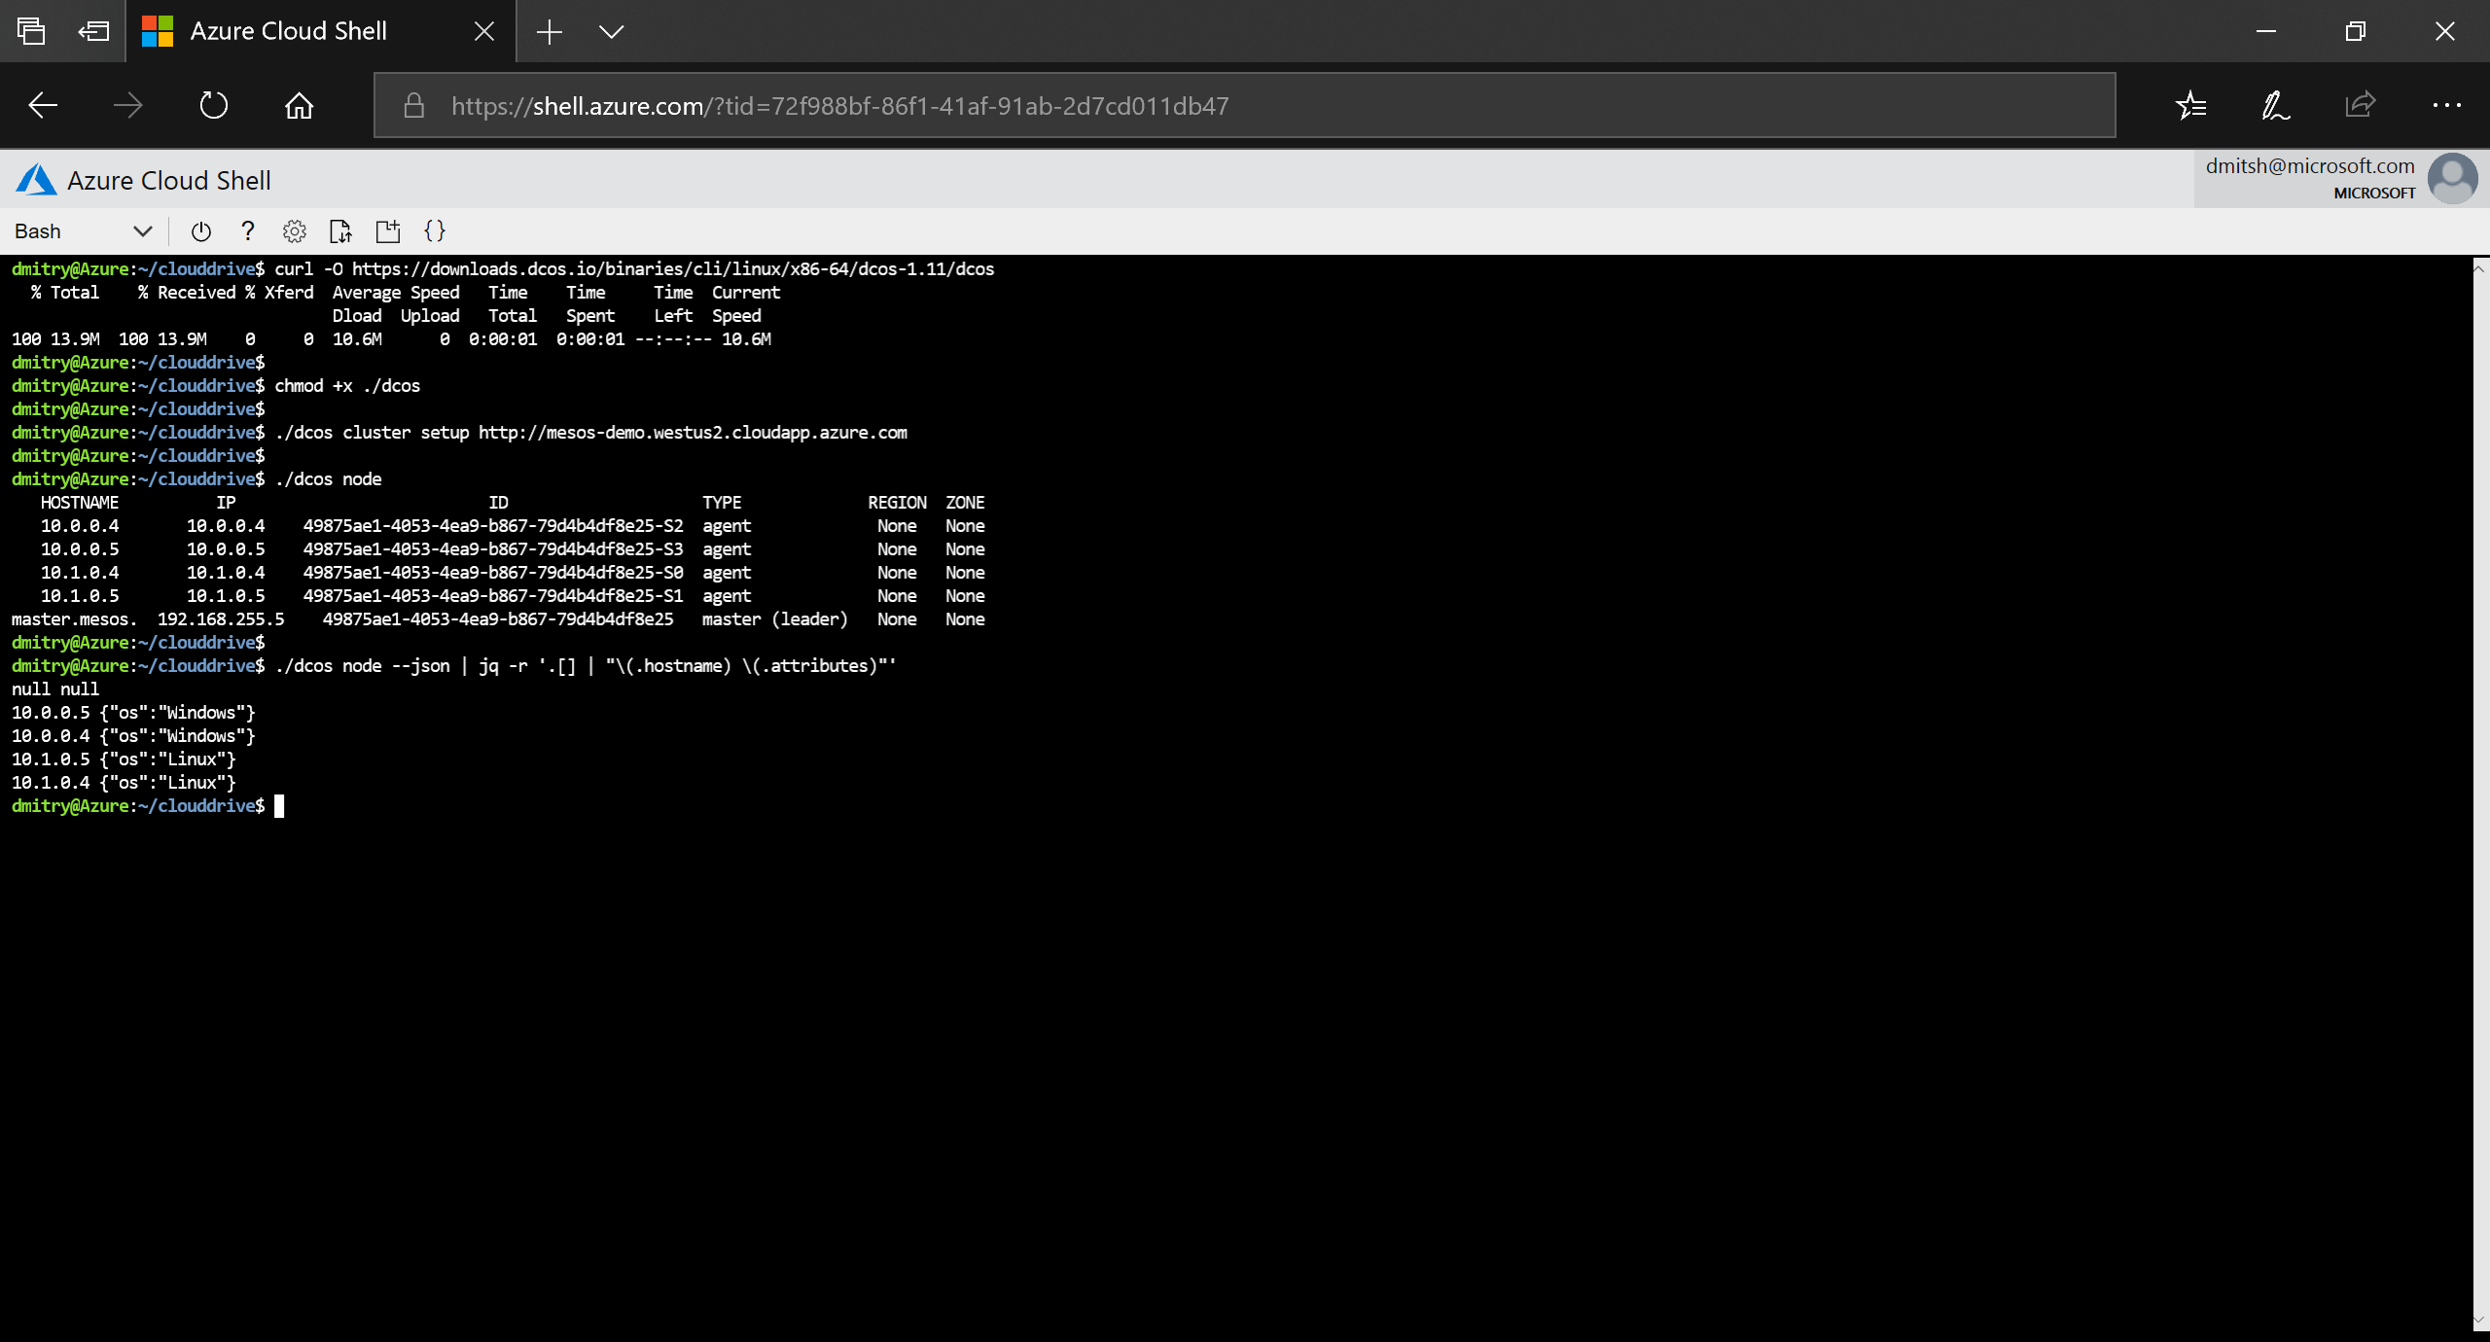
Demo: cluster deployment (cont.)

Slide 33
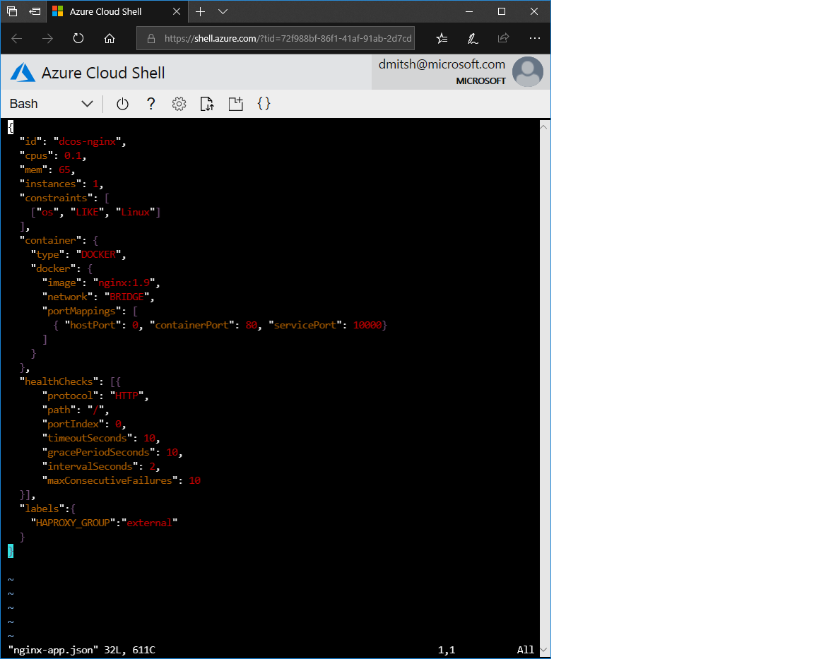
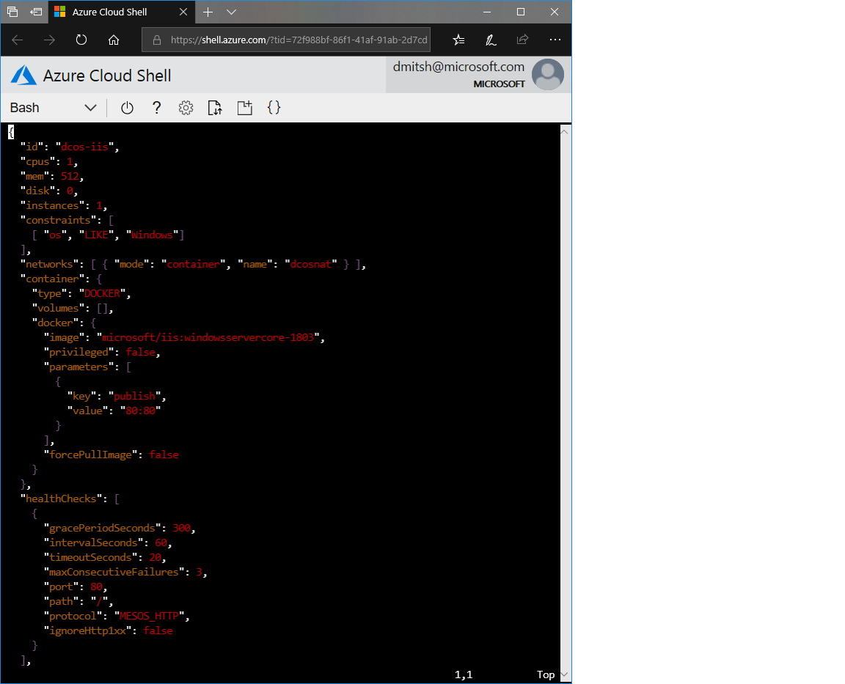
Demo: marathon apps

Slide 34
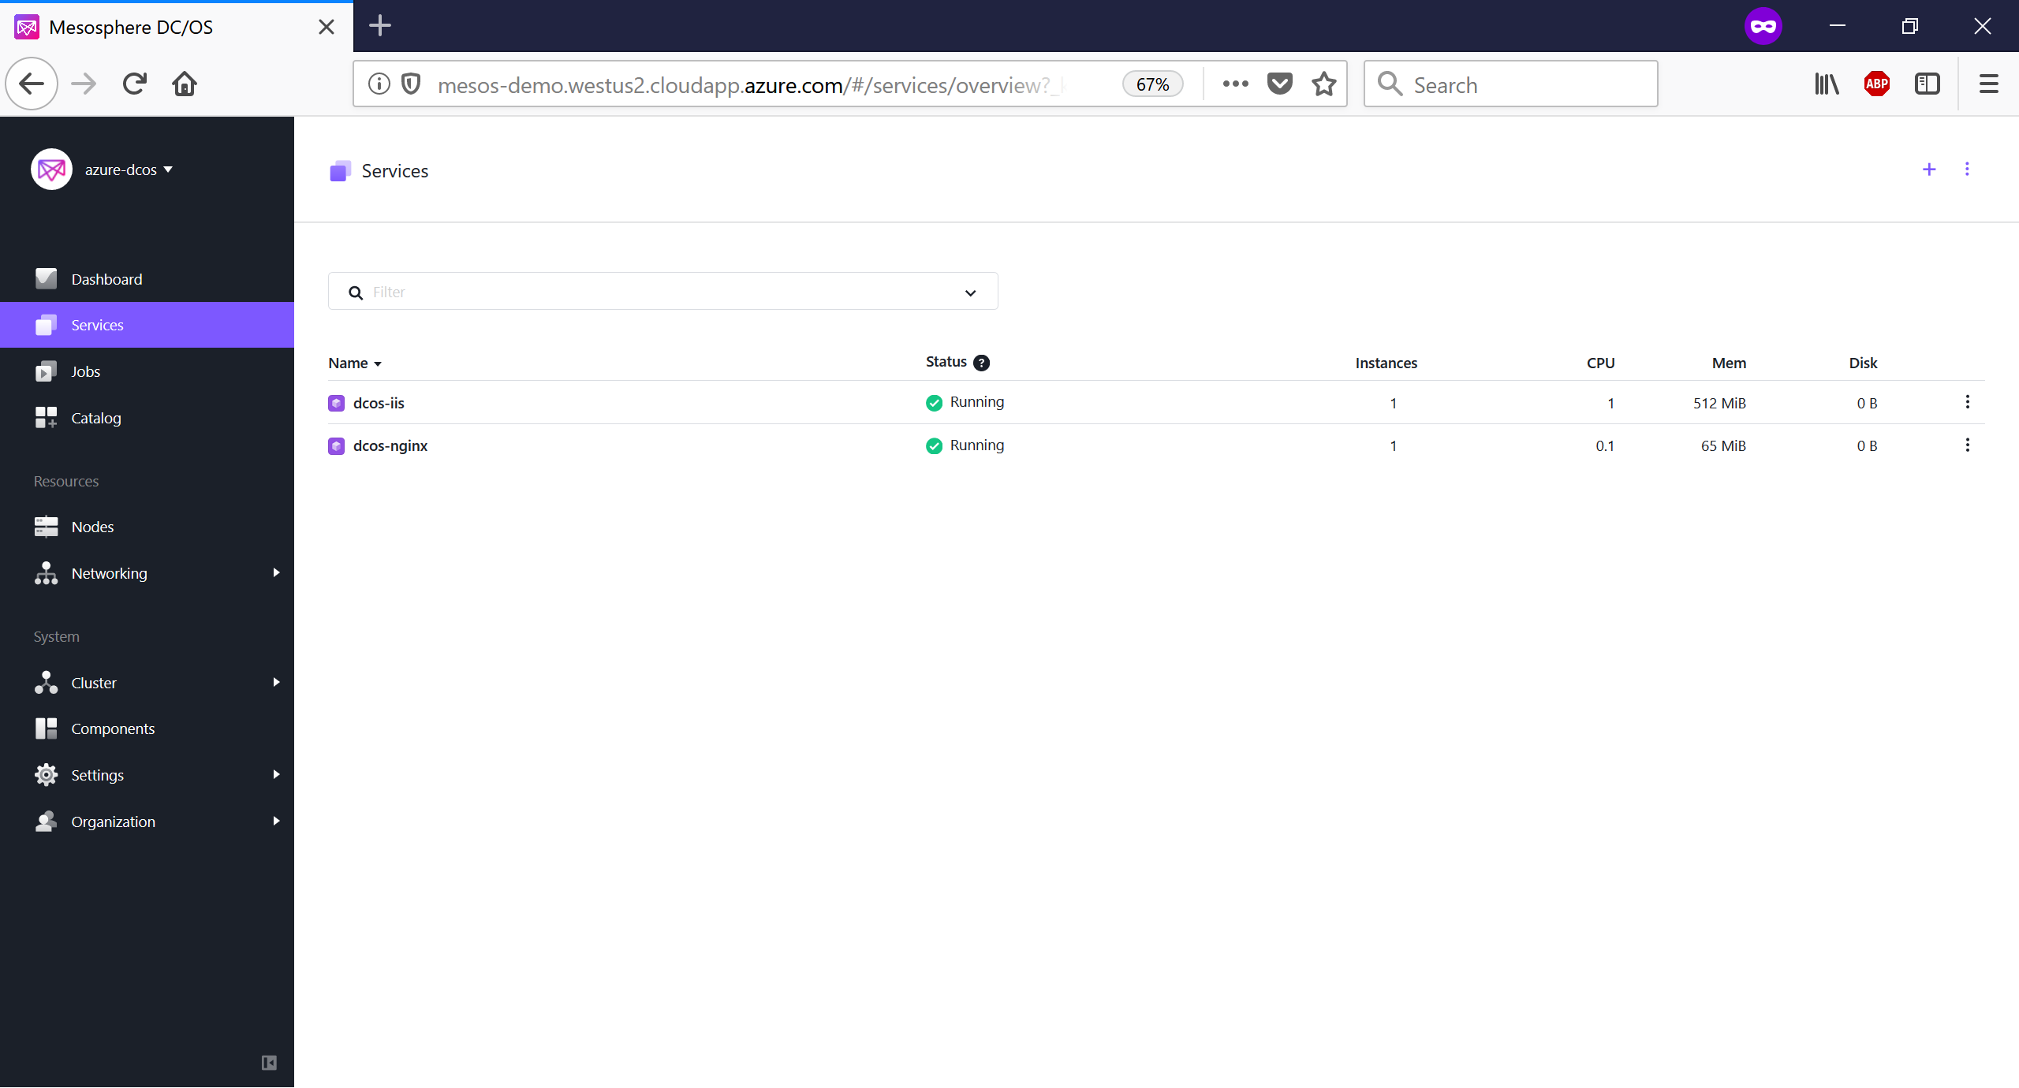
Demo: marathon apps (cont.)

Slide 35
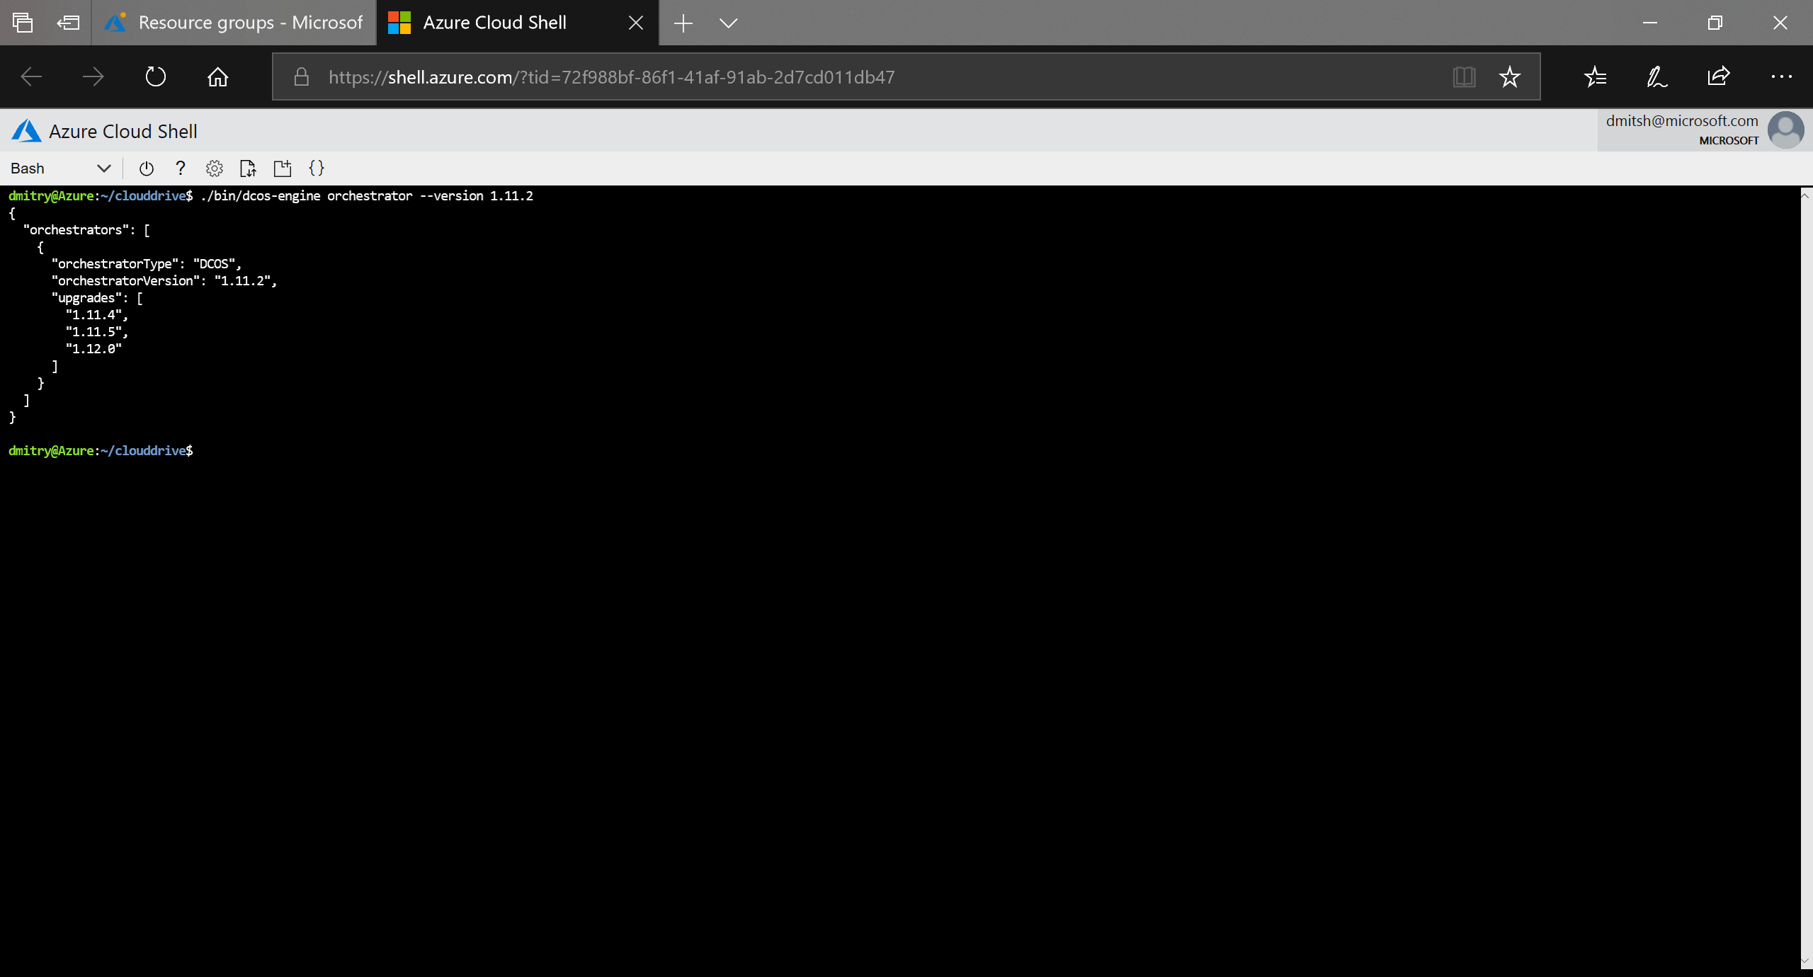
Demo: DC/OS upgrade

Slide 36
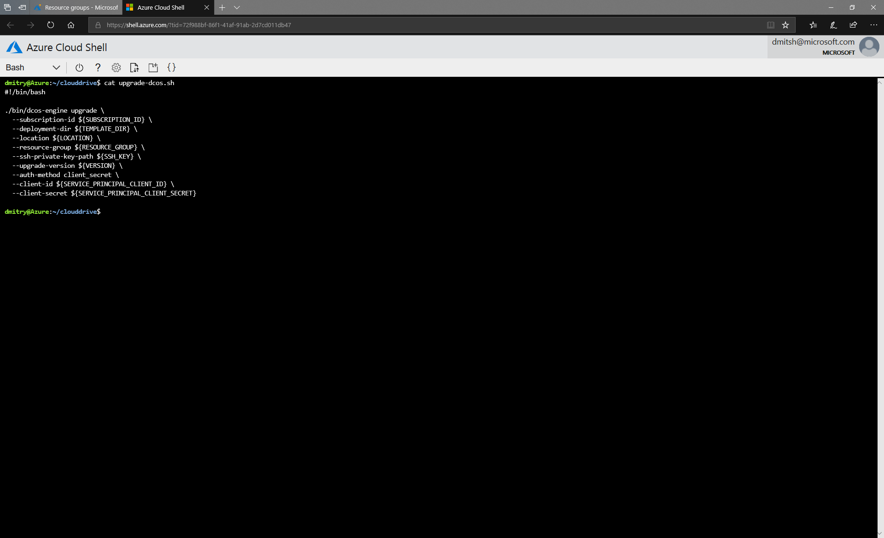
Demo: DC/OS upgrade (cont.)

Slide 37
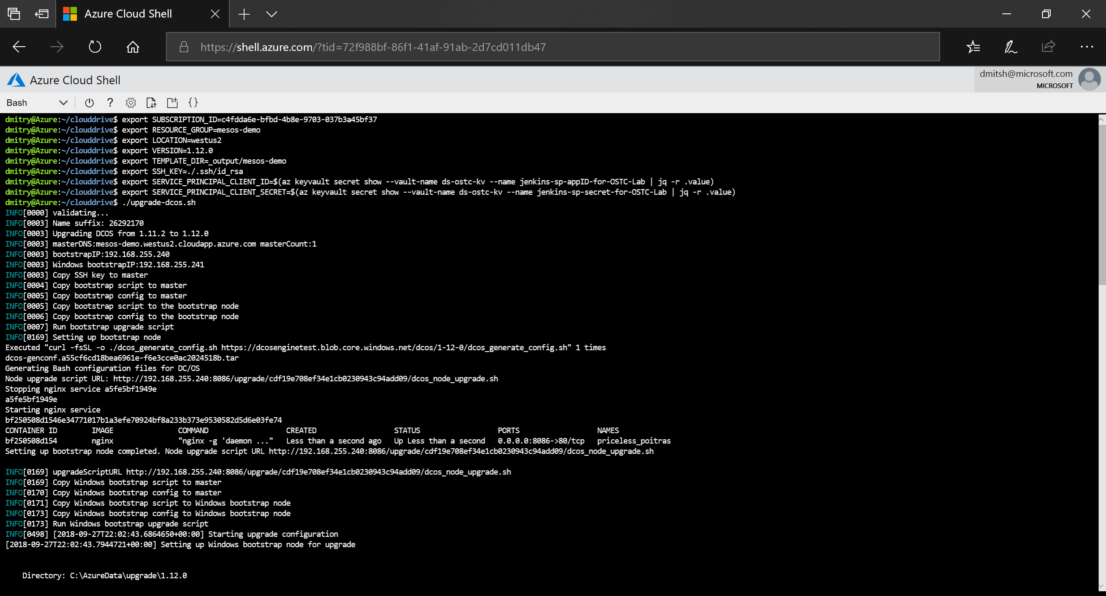
Demo: DC/OS upgrade (cont.)

Slide 38
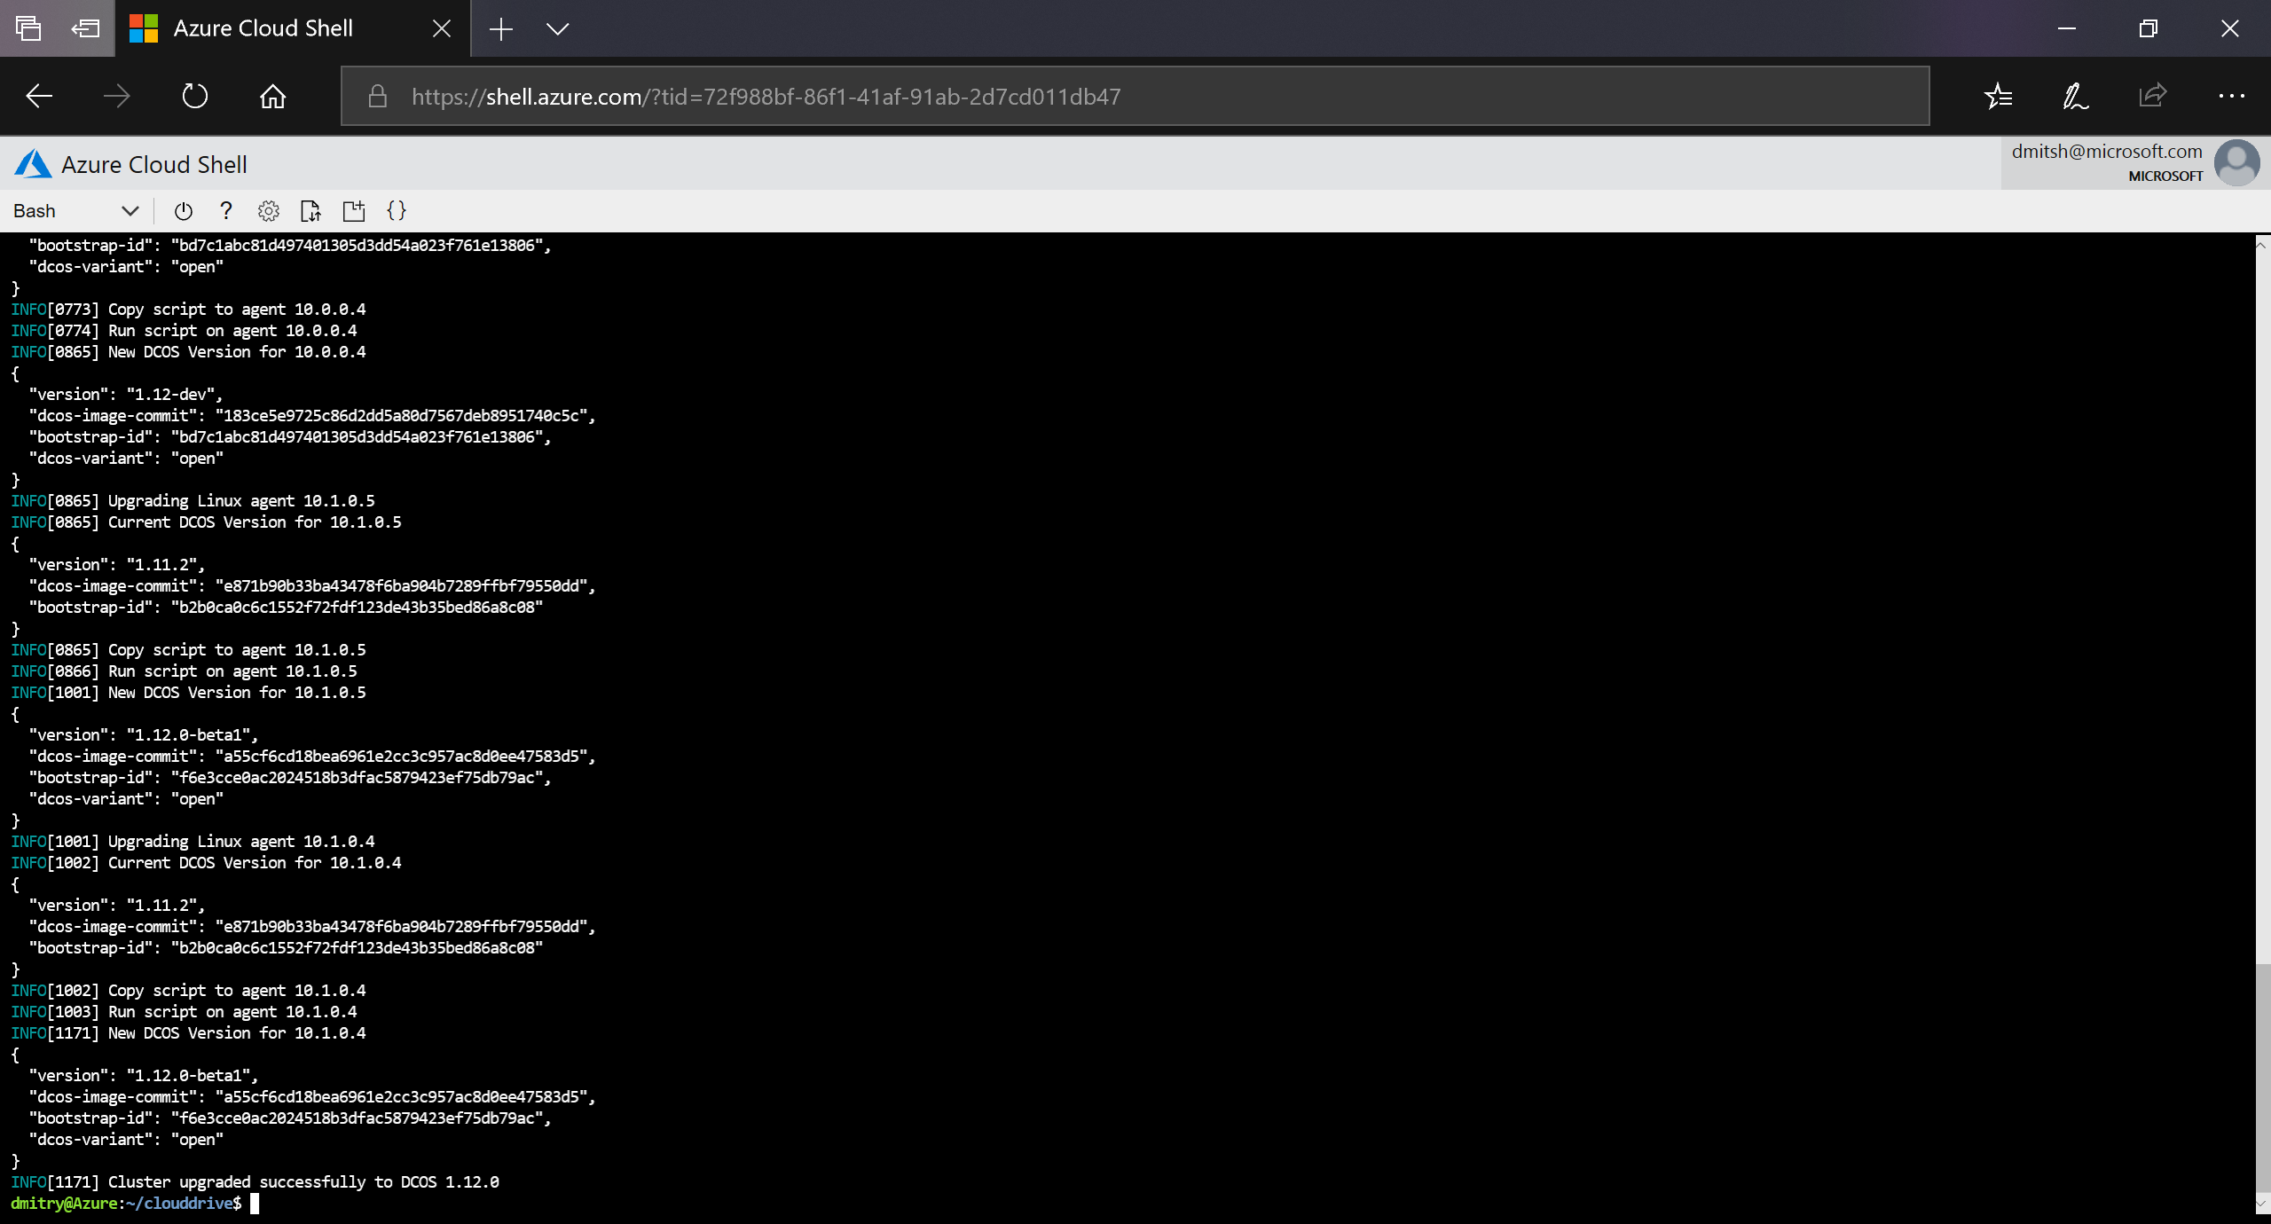
Demo: DC/OS upgrade (cont.)

Slide 39

Demo: DC/OS upgrade (cont.)

Slide 40
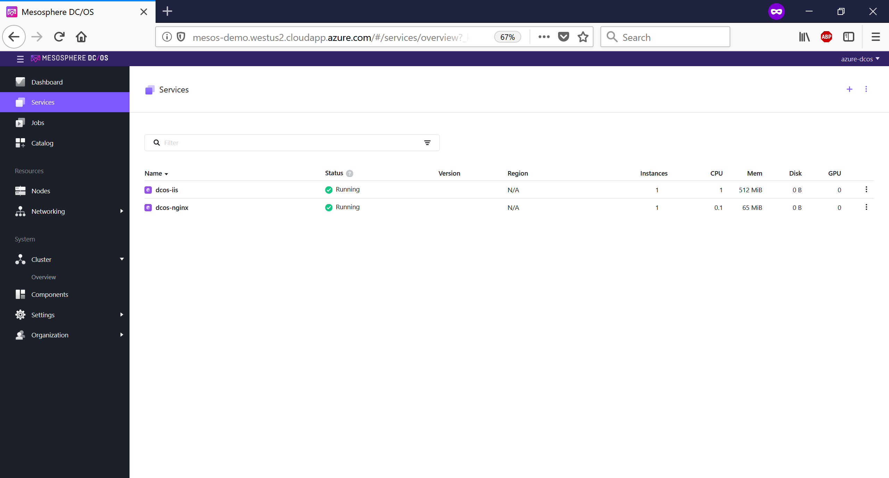
Demo: DC/OS upgrade (cont.)

Slide 41
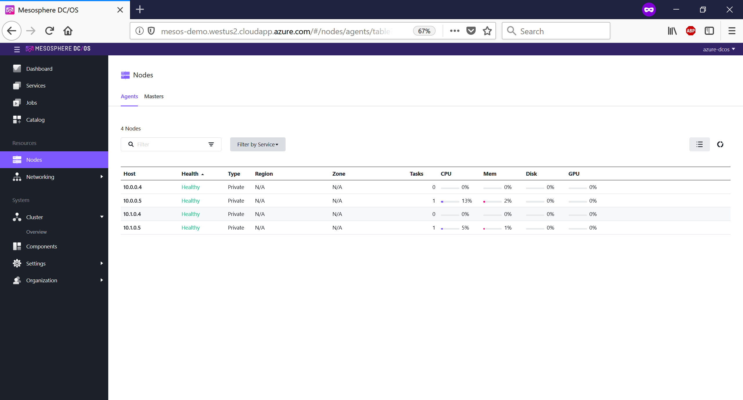
Demo: DC/OS upgrade (cont.)

Slide 42
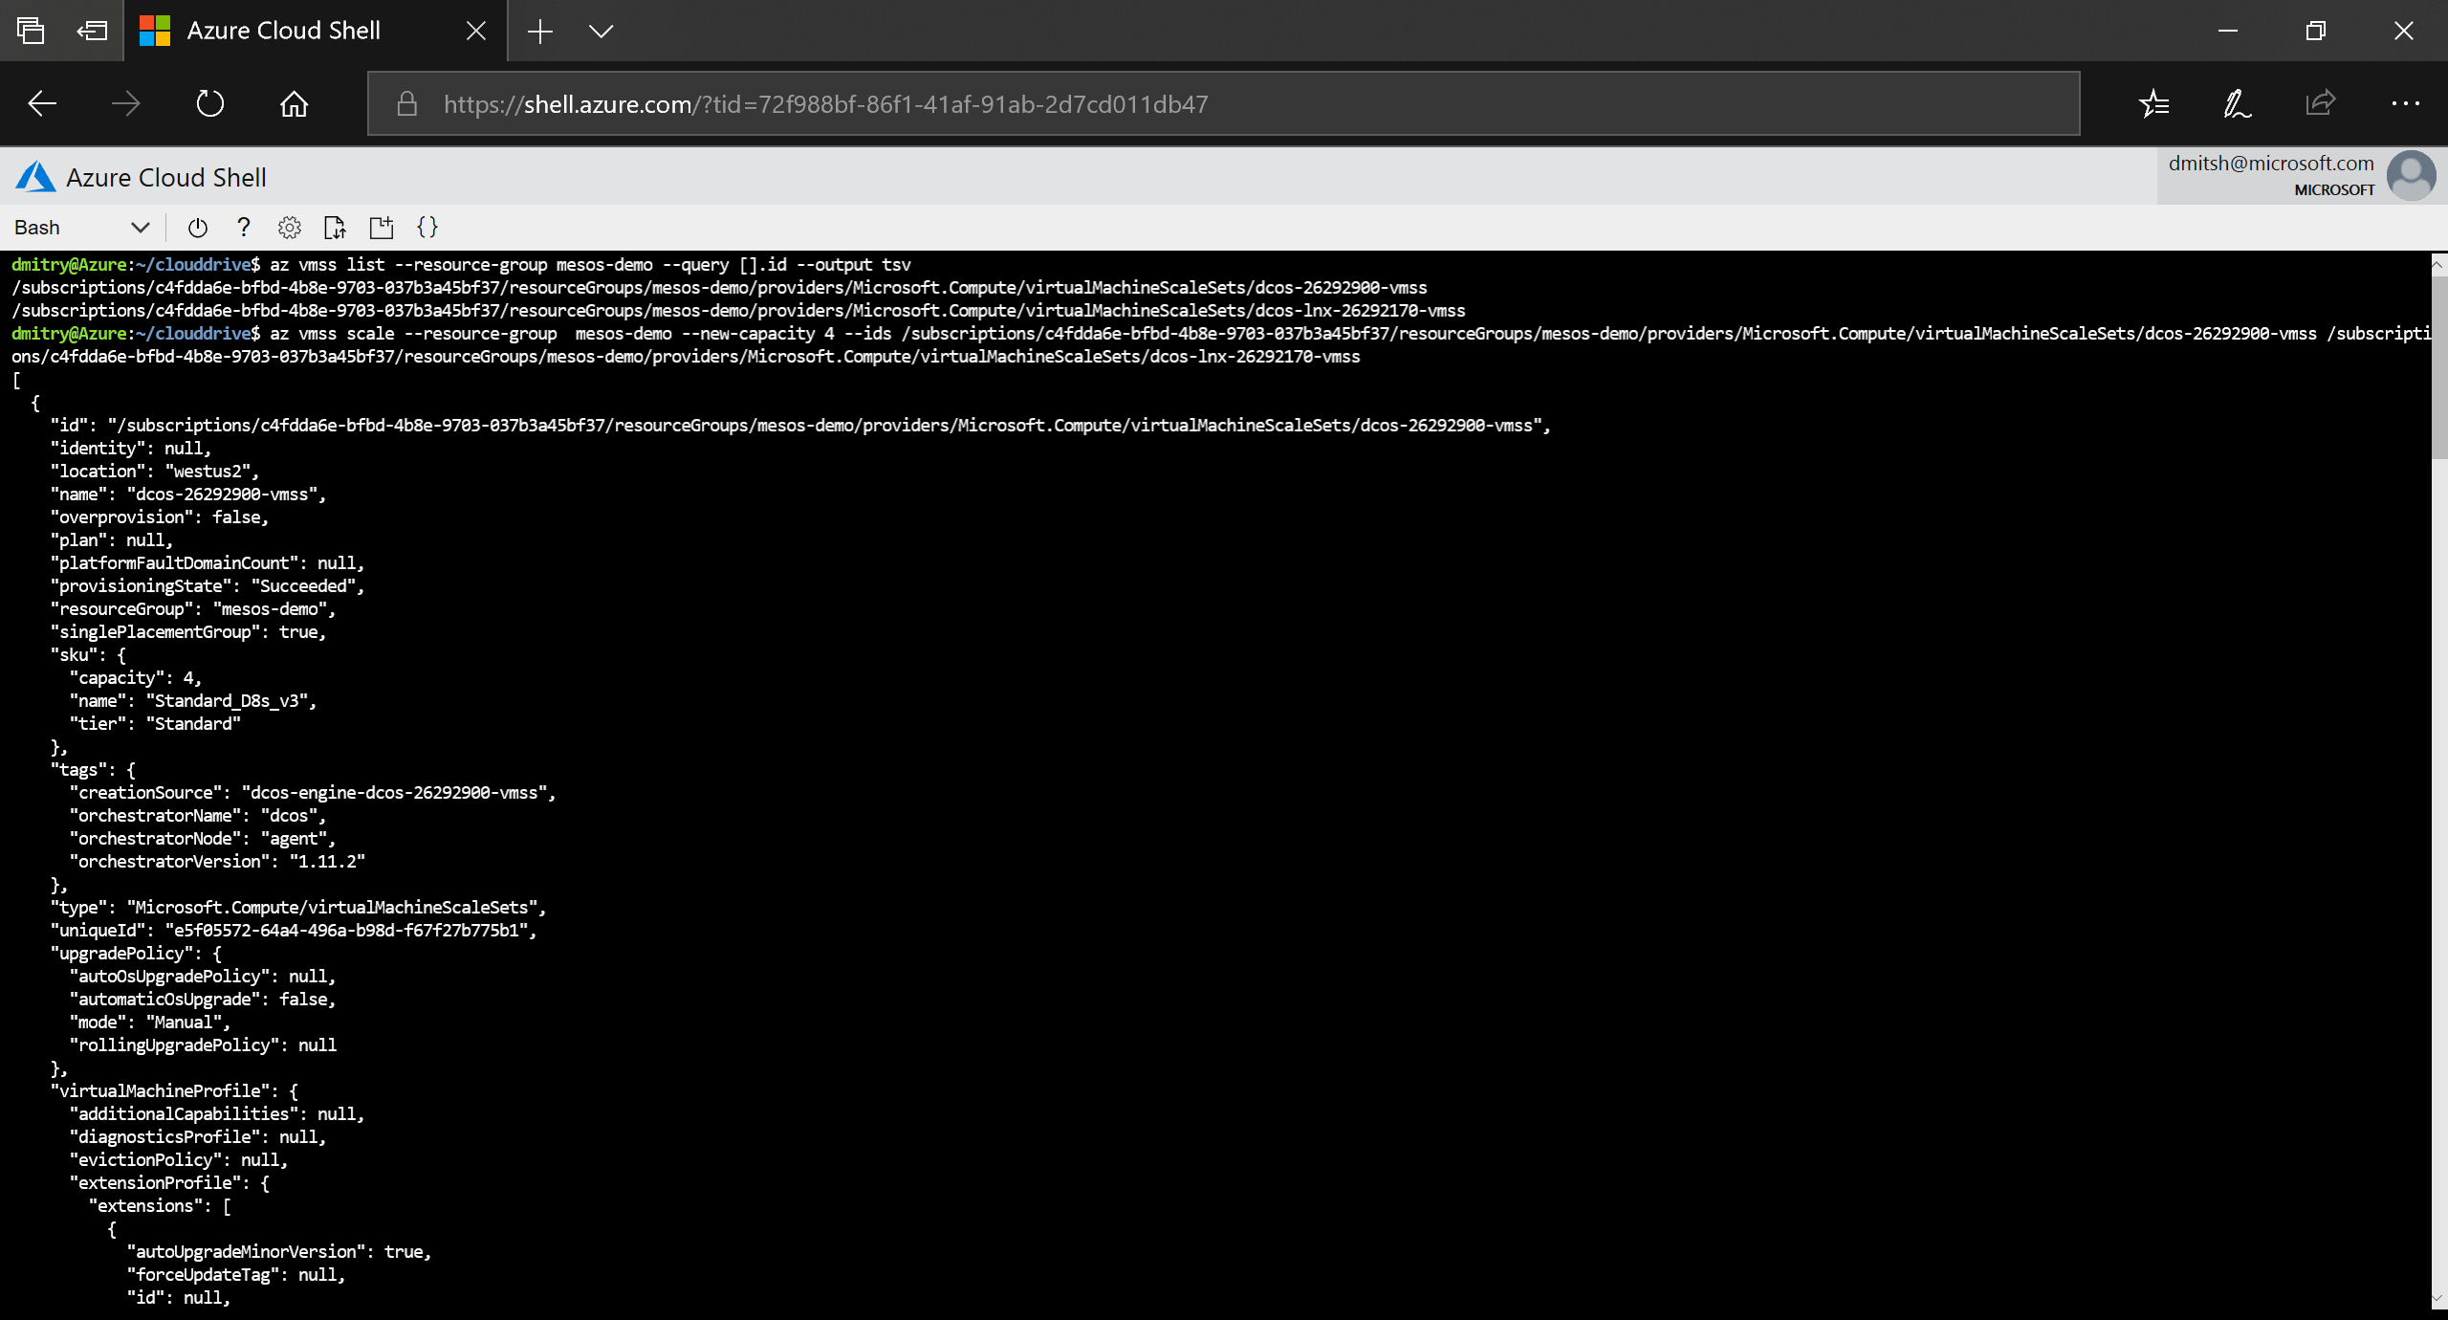
Demo: scaling

Slide 43
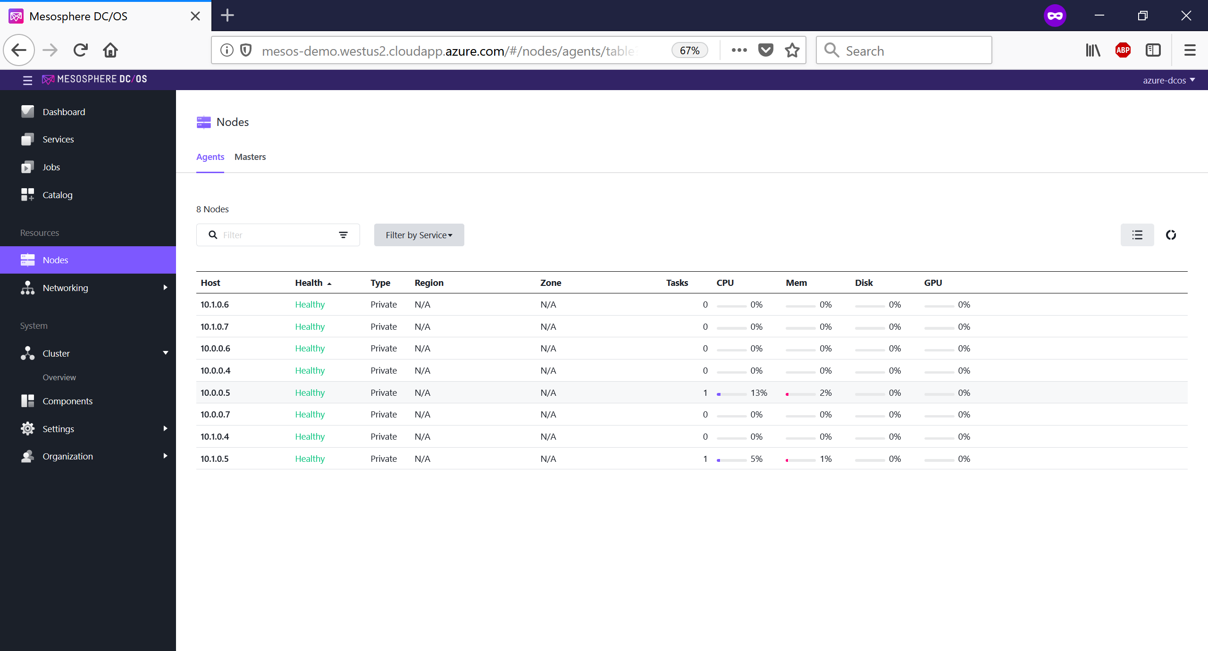
Demo: scaling (cont.)

Slide 44

Demo: scaling (cont.)

Slide 45
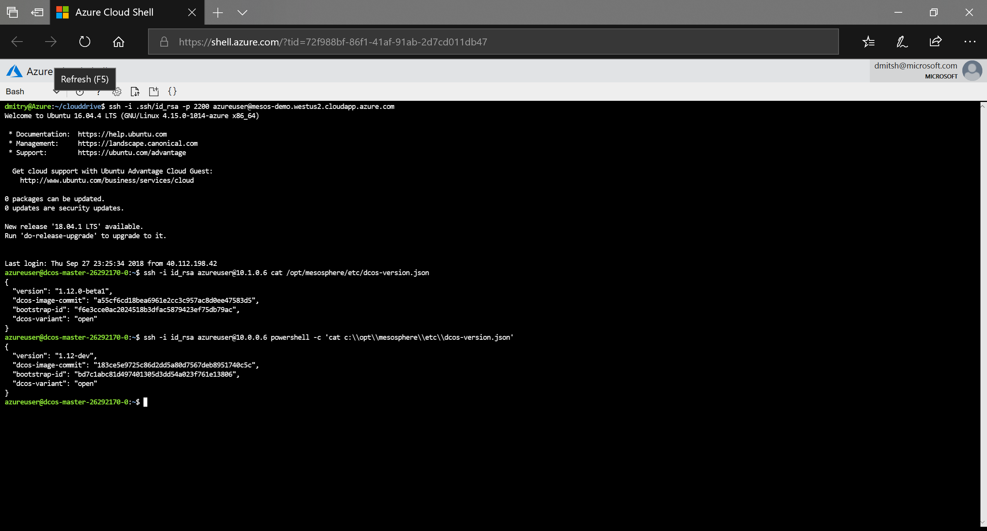
Demo: scaling (cont.)

Slide 46
Going forward …
Features
Adding support for upcoming DC/OS releases in dcos-engine
Continue contributing to open source projects
https://github.com/Azure/dcos-engine
https://github.com/dcos/dcos
https://github.com/dcos/dcos-windows
https://github.com/apache/mesos
Continue collaboration with Mesosphere

Slide 47

https://github.com/docs/dcos-engine/dcos-engine.pptx
https://github.com/Azure/dcos-engine/issues

